Slide 1
UNIT III
NETWORK LAYER
Network Layer Services – Packet switching –
Performance – IPV4 Addresses – Forwarding
of IP Packets - Network Layer Protocols: IP,
ICMP v4 – Unicast Routing Algorithms –
Protocols – Multicasting Basics – IPV6
Addressing – IPV6 Protocol.

Slide 2
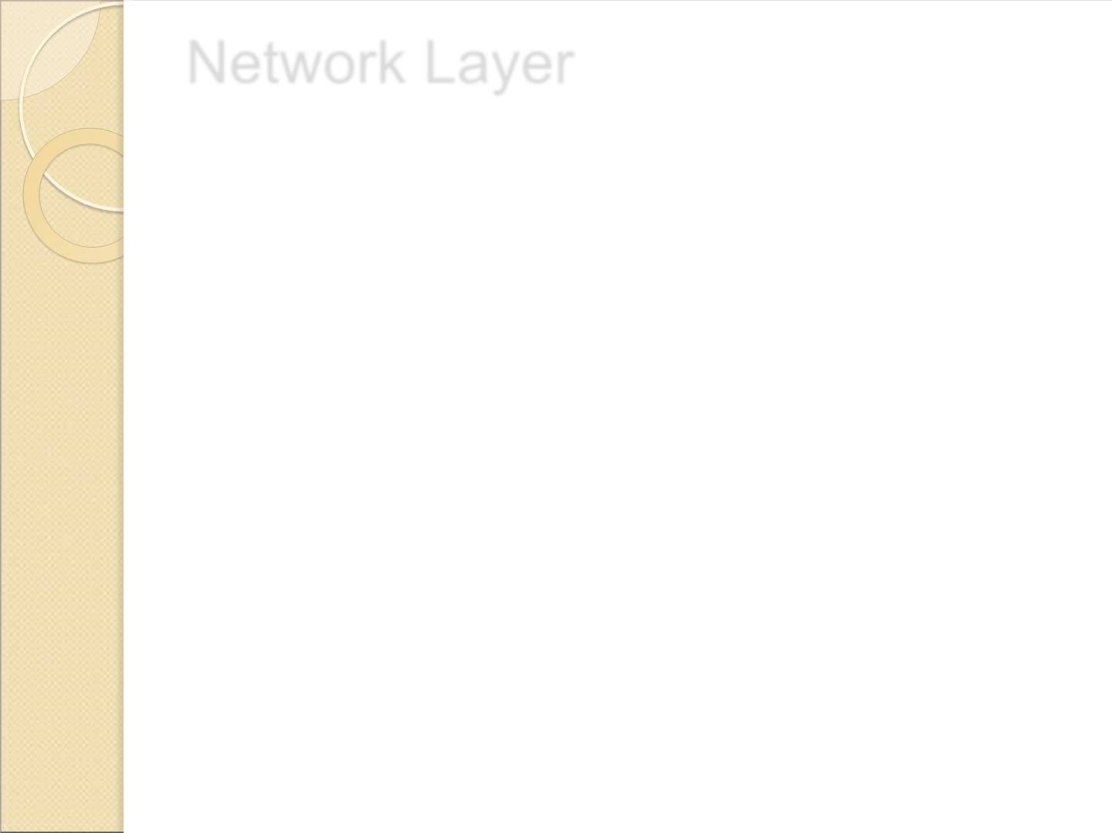
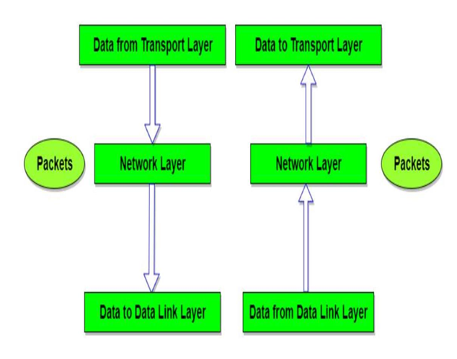
Network Layer
 The Network Layer is the third layer of the OSI model.
 It handles the service requests from the transport layer and
further forwards the service request to the data link layer.

Slide 3
Network Layer
.
 The network layer translates the logical addresses into physical
addresses
 It determines the route from the source to the destination and
also manages the traffic problems such as switching, routing and
controls the congestion of data packets.
 The main role of the network layer is to move the packets
from sending host to the receiving host.

Slide 4
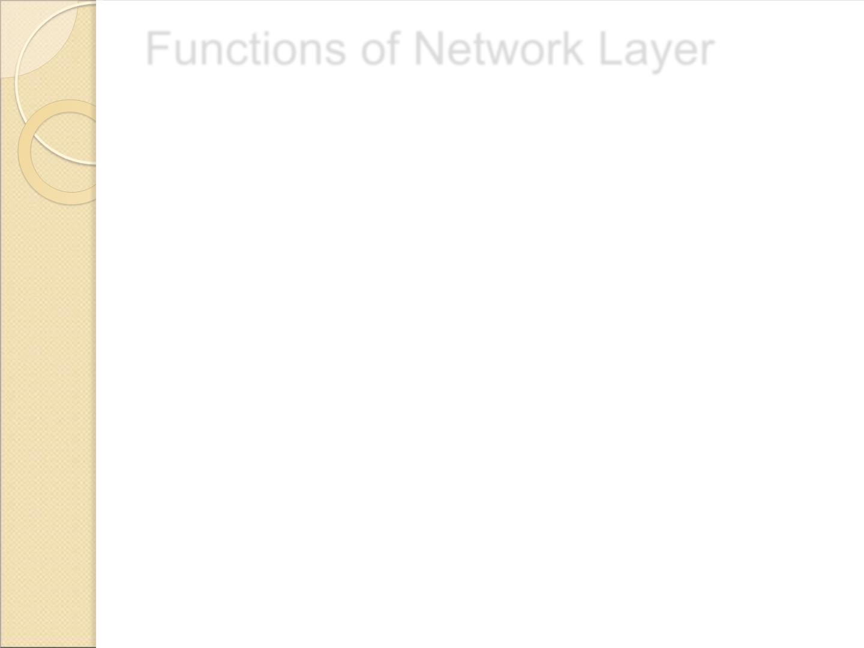
Functions of Network Layer
 Routing: When a packet reaches the router's input link, the
router will move the packets to the router's output link.
 Logical Addressing: The data link layer implements the
physical addressing and network layer implements the logical
addressing. Logical addressing is also used to distinguish
between source and destination system. The network layer
adds a header to the packet which includes the logical
addresses of both the sender and the receiver.

Slide 5
Functions of Network Layer
 Internetworking: This is the main role of the
network layer that it provides the logical
connection between different types of
networks.
 Fragmentation: The fragmentation is a process
of breaking the packets into the smallest
individual data units that travel through different
networks.

Slide 6

Features
 Main responsibility of Network layer is to carry the data
packets from the source to the destination without
changing or using it.
 If the packets are too large for delivery, they are
fragmented i.e., broken down into smaller packets.
 It decides the root to be taken by the packets to travel
from the source to the destination among the multiple
roots available in a network (also called as routing).
 The source and destination addresses are added to the
data packets inside the network layer.

Slide 7
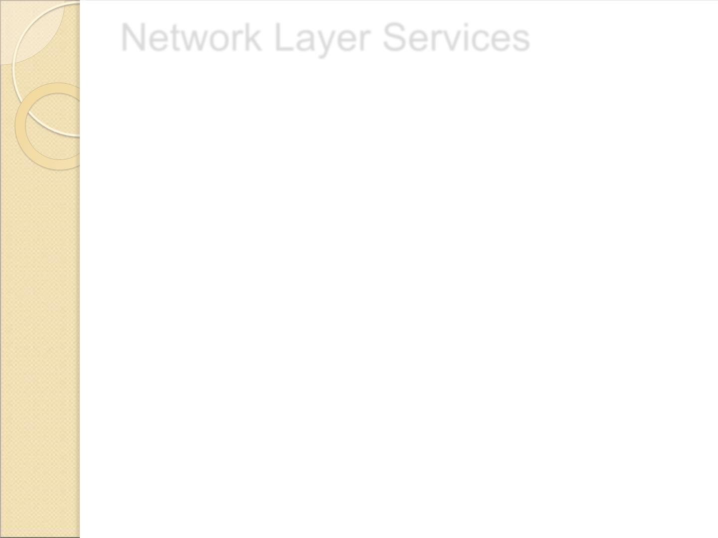
Network Layer Services
 Guaranteed delivery: This layer provides the service
which guarantees that the packet will arrive at its
destination.
 Guaranteed delivery with bounded delay: This
service guarantees that the packet will be delivered
within a specified host-to-host delay bound.
 In-Order packets: This service ensures that the packet
arrives at the destination in the order in which they
are sent.

Slide 8
Network Layer Services
 Guaranteed max jitter: This service ensures that the amount of
time taken between two successive transmissions at the sender is
equal to the time between their receipt at the destination.

Slide 9
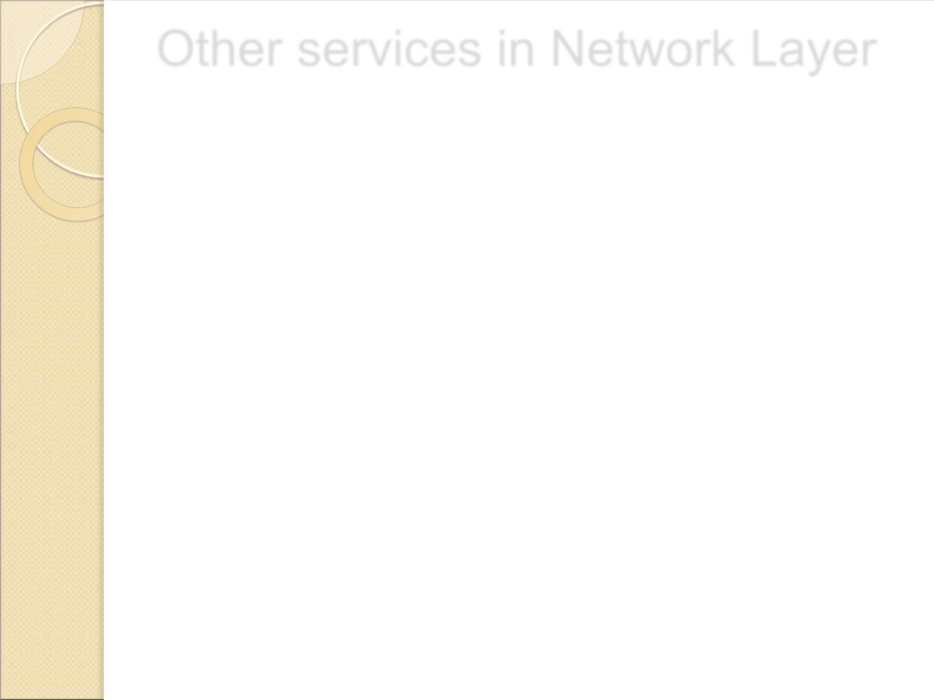
Other services in Network Layer
 Congestion Control: Congestion occurs when the number of
datagrams sent by source is beyond the capacity of network or
routers. This is another issue in the network layer protocol. If
congestion continues, sometimes a situation may arrive where the
system collapses and no datagrams are delivered. Although
congestion control is indirectly implemented in network layer, but
still there is a lack of congestion control in the network layer.

Slide 10
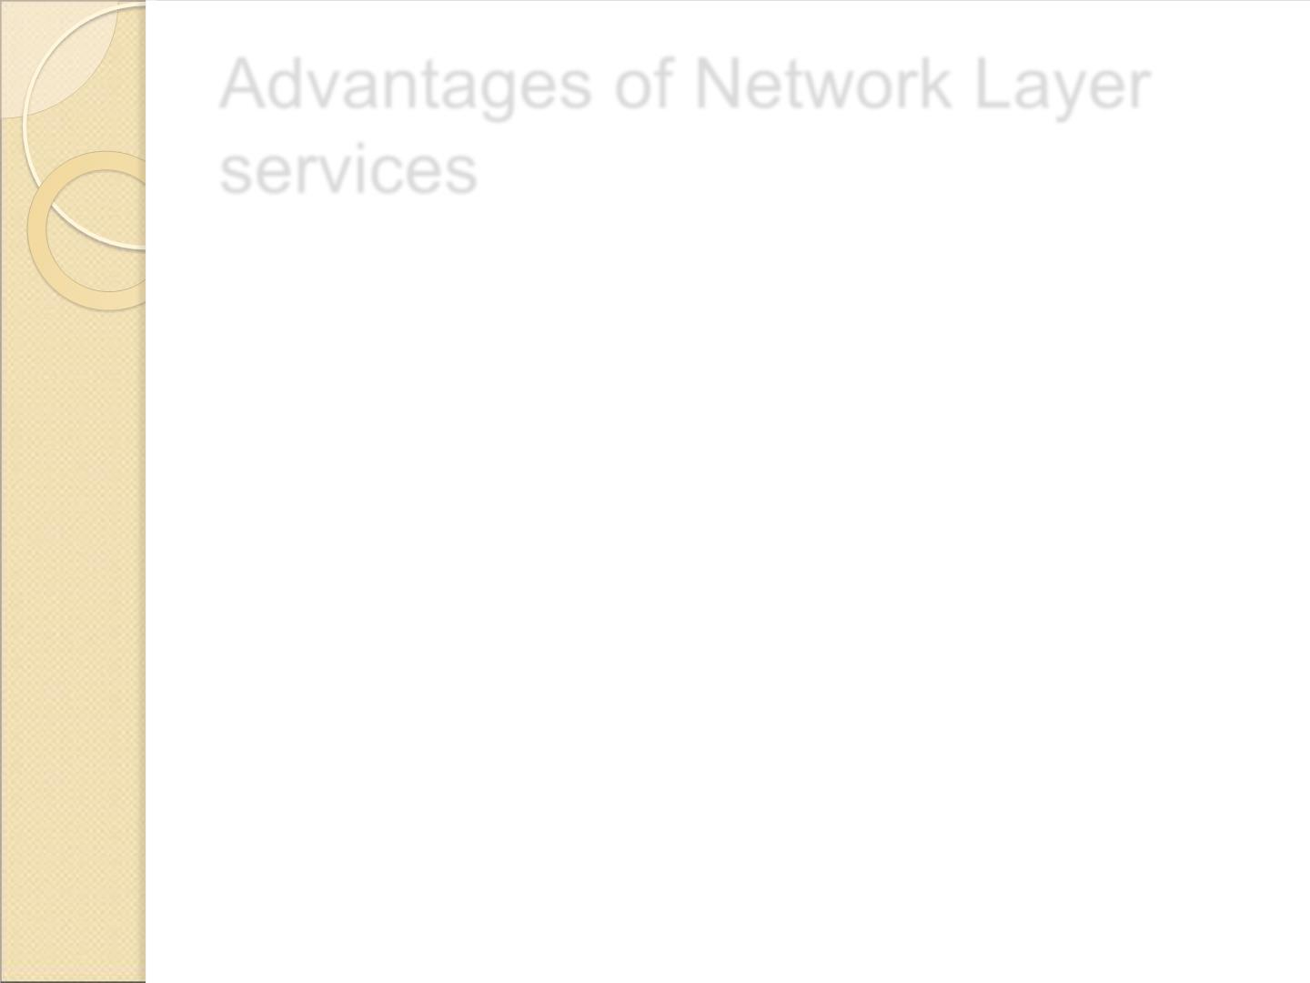
Advantages of Network Layer
services
 Packetization service in network layer provides an
ease of transportation of the data packets.
 Packetization also eliminates single points of failure in
data communication systems.
 Routers present in the network layer reduce network
traffic by creating collision and broadcast domains.
 With the help of Forwarding, data packets are
transferred from one place to another in the network.

Slide 11
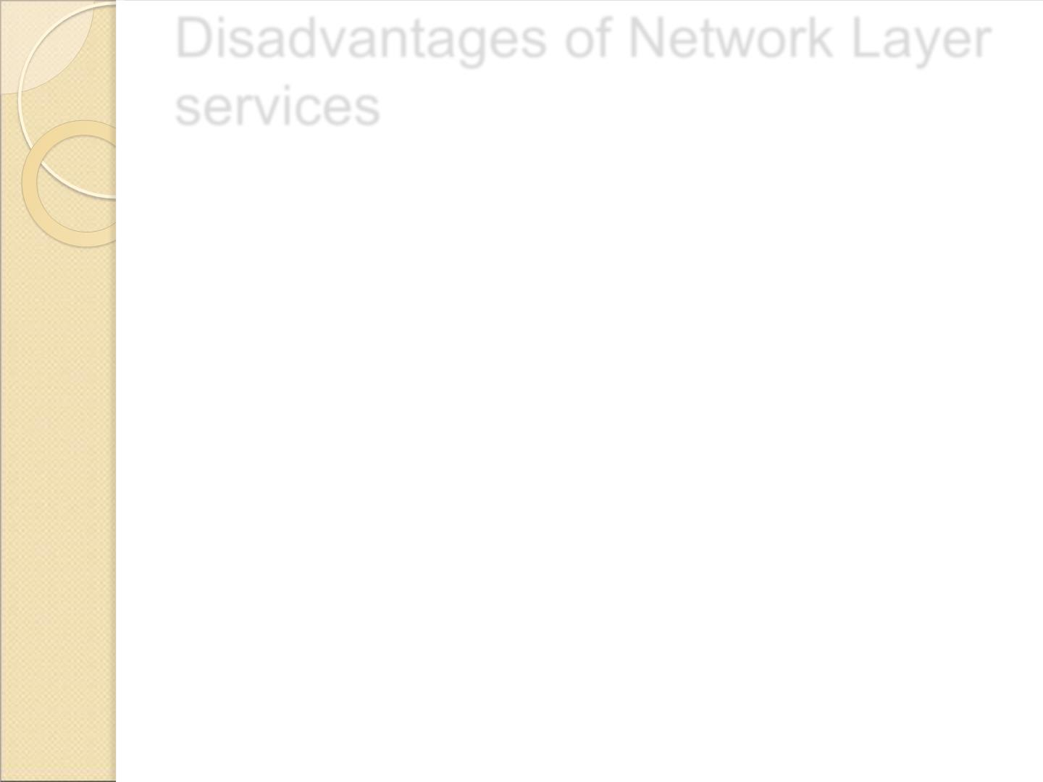
Disadvantages of Network Layer
services
 There is a lack of flow control in the design of the network
layer.
 Congestion occurs sometimes due to the presence of too many datagrams in a network which are beyond the capacity of
network or the routers. Due to this, some routers may drop
some of the datagrams and some important piece of
information maybe lost.
 Although indirectly error control is present in network layer, but there is a lack of proper error control mechanisms as due to presence of fragmented data packets, error control becomes difficult to implement.

Slide 12
Packet switching
 Packet switching is a method of transferring the data to
a network in form of packets. In order to transfer the file
fast and efficient manner over the network and minimize
the transmission latency, the data is broken into small
pieces of variable length, called Packet.
 At the destination, all these small-parts (packets) has to
be reassembled, belonging to the same file. A packet
composes of payload and various control information.
No pre-setup or reservation of resources is needed.

Slide 13
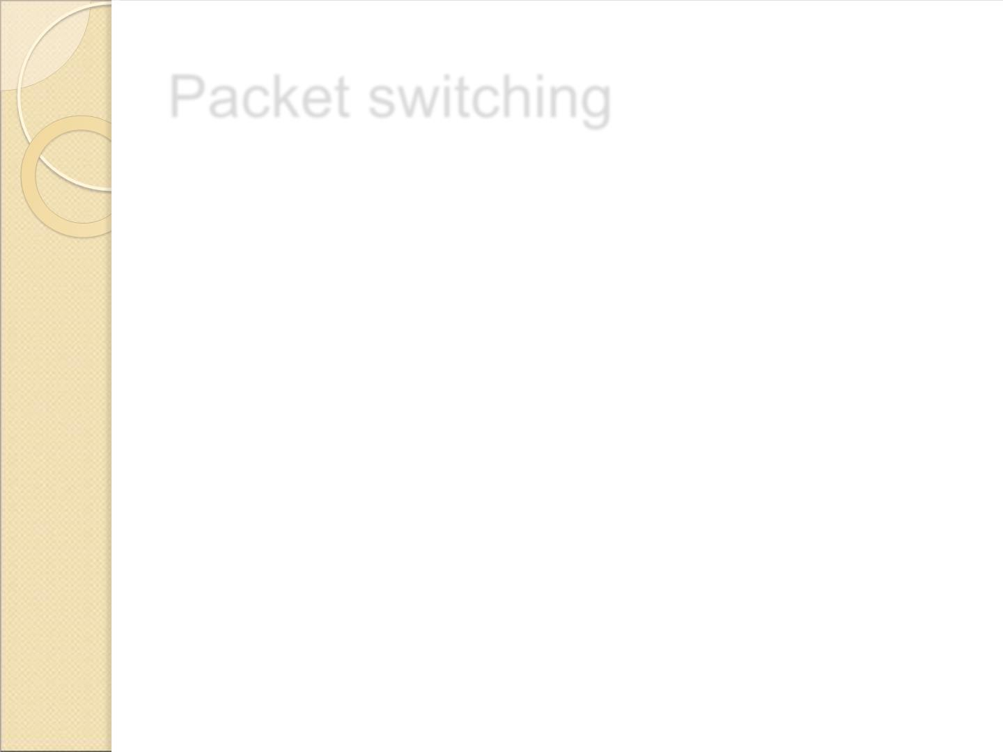
Packet switching
 Packet Switching uses Store and Forward technique
while switching the packets; while forwarding the
packet each hop first store that packet then forward. This
technique is very beneficial because packets may get
discarded at any hop due to some reason.
 Packet-Switched networks were designed to overcome
the weaknesses of Circuit-Switched networks since
circuit-switched networks were not very effective for
small messages.

Slide 14
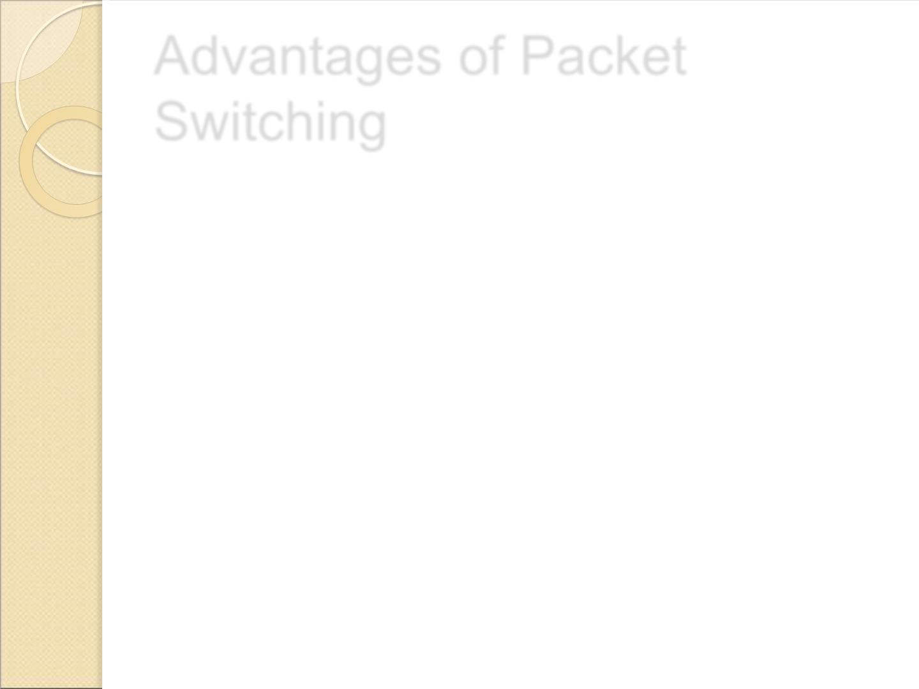
Advantages of Packet
Switching
 More efficient in terms of bandwidth, since the concept
of reserving circuit is not there.
 Minimal transmission latency.
 More reliable as destination can detect the missing
packet.
 More fault tolerant because packets may follow different
path in case any link is down, Unlike Circuit Switching.
 Cost effective and comparatively cheaper to implement.

Slide 15
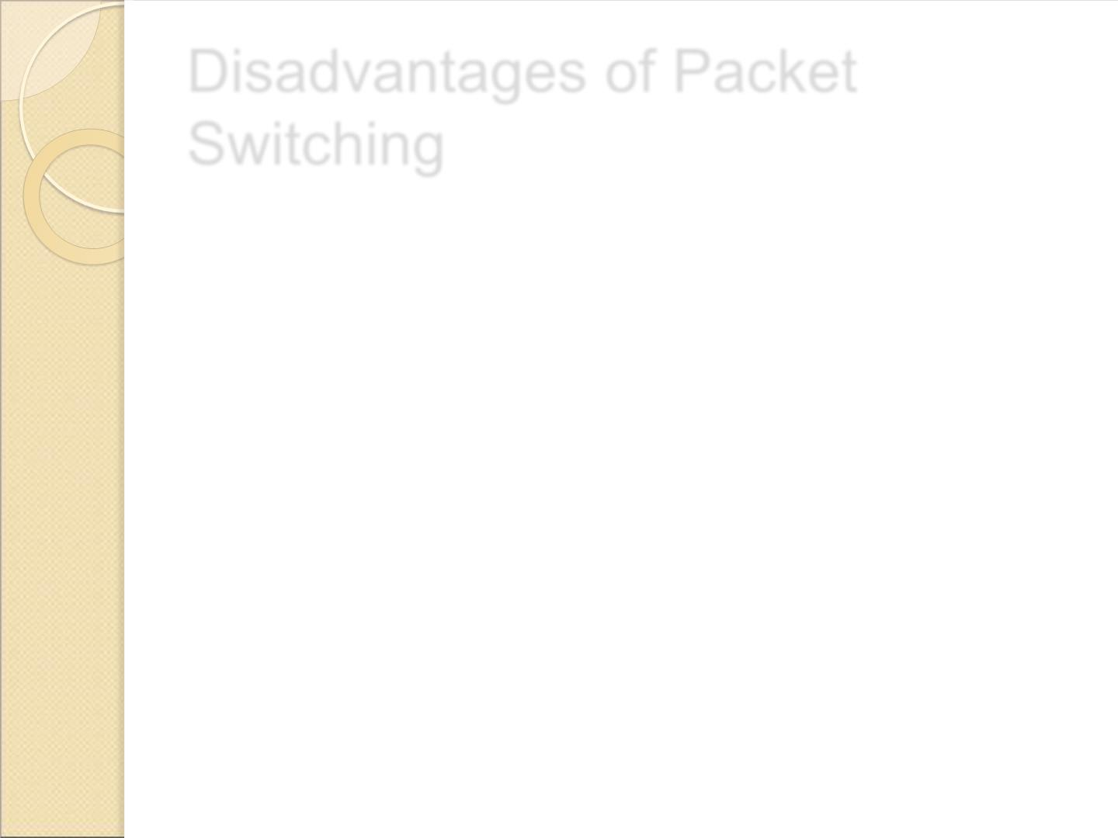
Disadvantages of Packet
Switching
 Packet Switching don’t give packets in order, whereas Circuit
Switching provides ordered delivery of packets because all
the packets follow the same path.
 Since the packets are unordered, we need to provide sequence
numbers to each packet.
 Complexity is more at each node because of the facility to
follow multiple path.
 Transmission delay is more because of rerouting.
 Packet Switching is beneficial only for small messages, but
for bursty data (large messages) Circuit Switching is better.

Slide 16
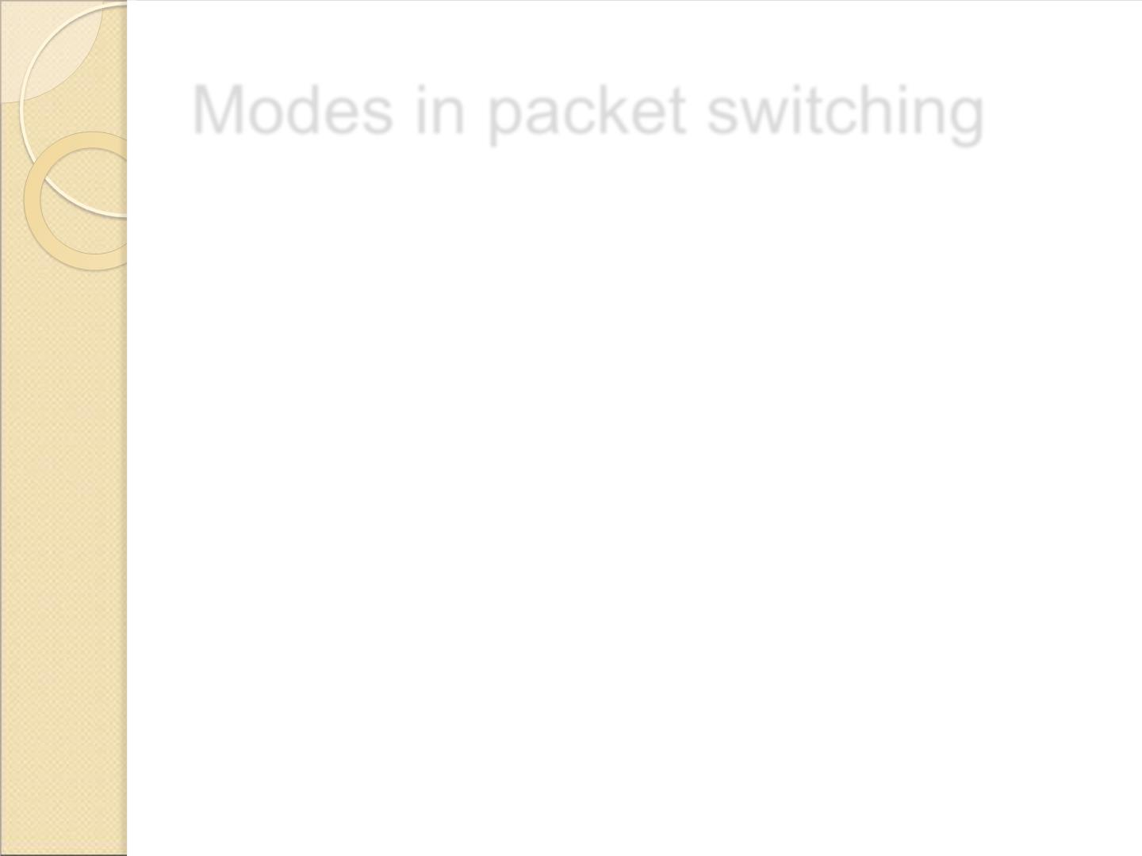
Modes in packet switching
 Connection oriented packet switching
 Connection less packet switching

Slide 17
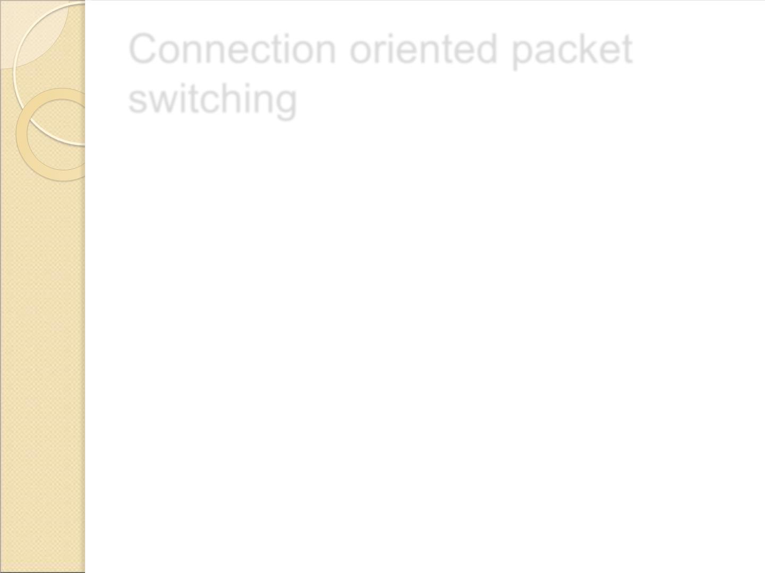
Connection oriented packet
switching
 Before starting the transmission, it establishes a logical path
or virtual connection using signalling protocol, between
sender and receiver and all packets belongs to this flow will
follow this predefined route.
 Virtual Circuit ID is provided by switches/routers to uniquely
identify this virtual connection.
 Data is divided into small units and all these small units are
appended with help of sequence number. Overall, three
phases takes place here- Setup, data transfer and tear down
phase.

Slide 18
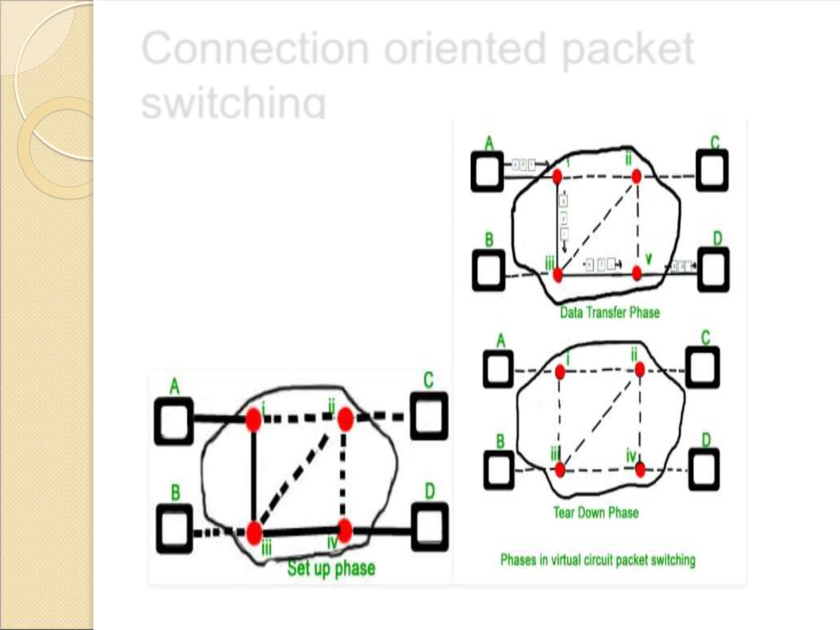
Connection oriented packet
switching
20

Slide 19
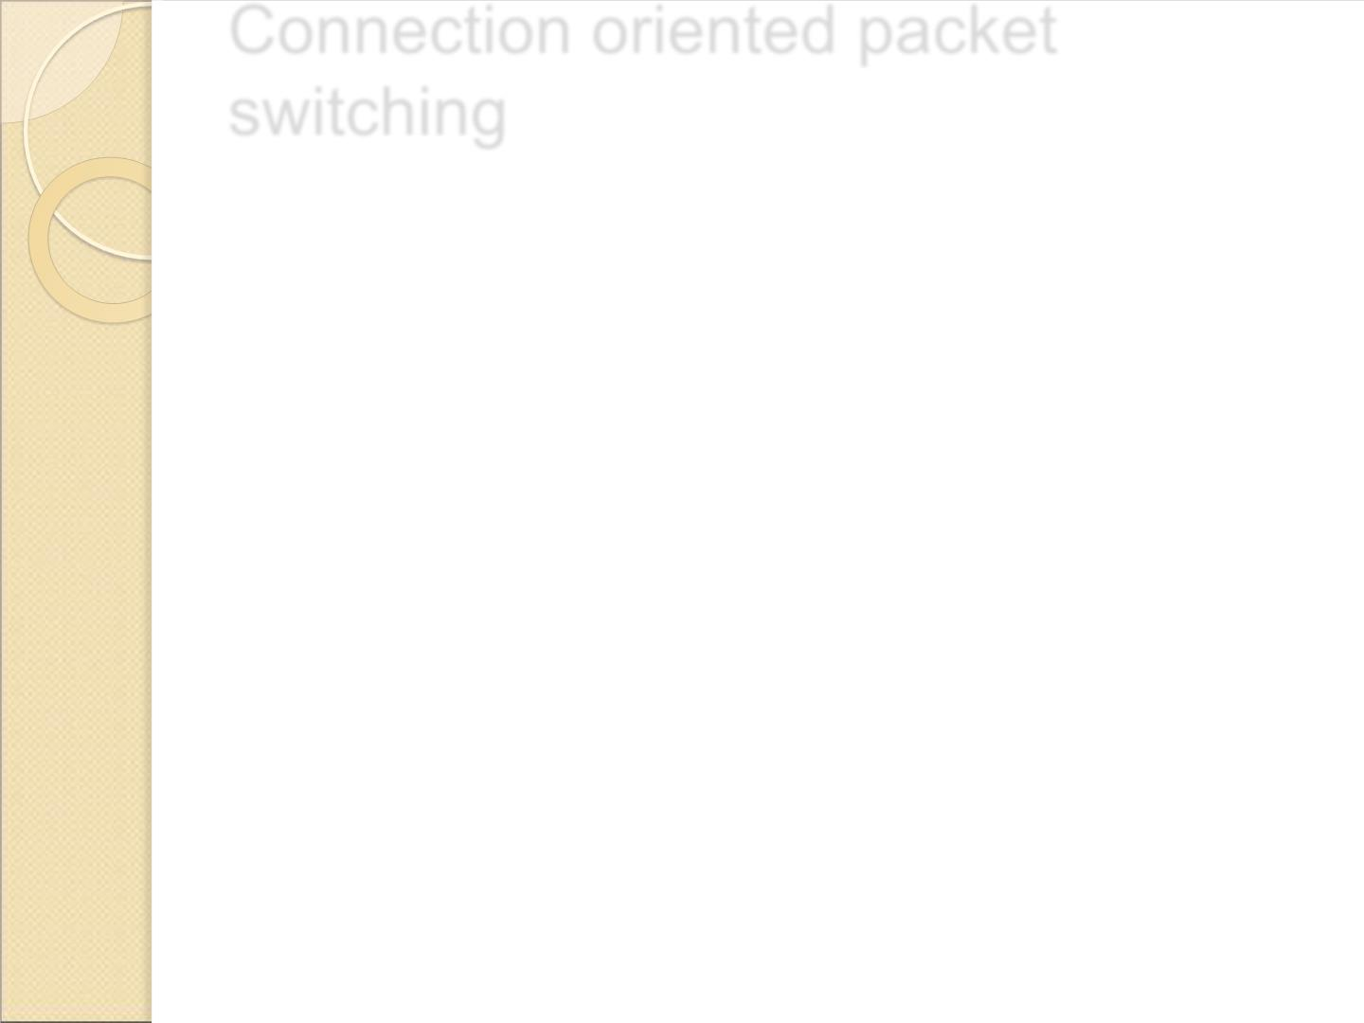
Connection oriented packet
switching
 All address information is only transferred during setup
phase. Once the route to destination is discovered, entry is
added to switching table of each intermediate node.
 During data transfer, packet header (local header) may
contain information such as length, timestamp, sequence
number etc.
Connection-oriented switching is very useful in switched
WAN.
 Some popular protocols which use Virtual Circuit Switching
approach are X.25, Frame-Relay, AT M and MPLS(Multi-
Protocol Label Switching).
21

Slide 20
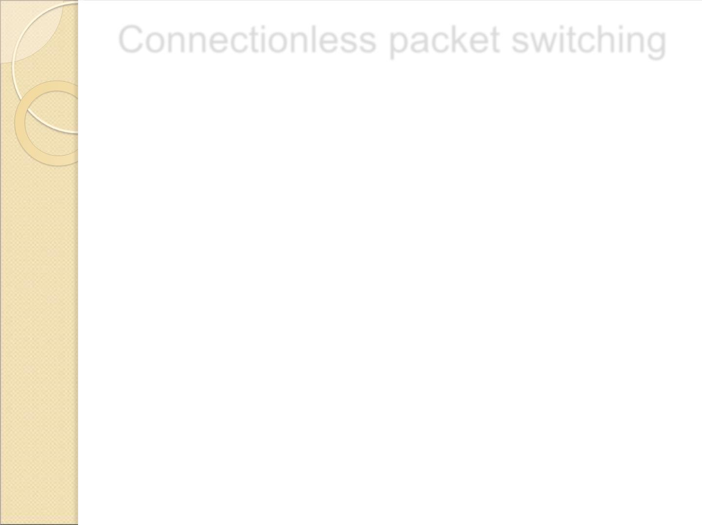
Connectionless packet switching
 In Connectionless Packet Switching each packet
contains all necessary addressing information such as
source address, destination address and port
numbers etc.
 In Datagram Packet Switching, each packet is treated
independently.
 Packets belonging to one flow may take different routes
because routing decisions are made dynamically, so the
packets arrived at destination might be out of order.
 It has no connection setup and teardown phase, like
Virtual Circuits.
 Packet delivery is not guaranteed in connectionless
packet switching, so the reliable delivery must be
provided by end systems using additional protocols.
22

Slide 21
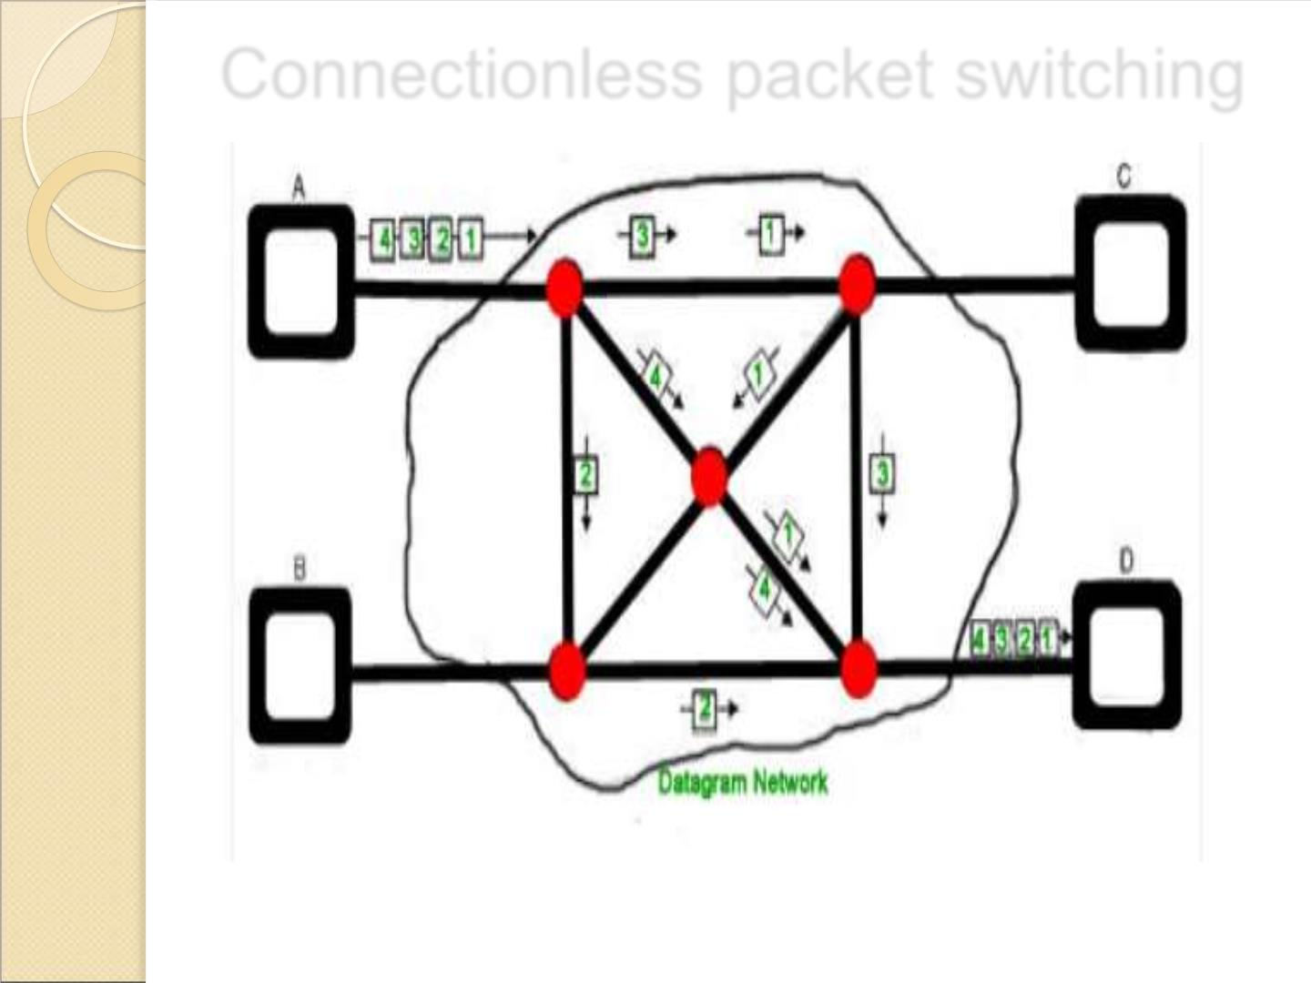
Connectionless packet switching
23

Slide 22
Delays in packet switching
 Transmission Delay
 Propagation Delay
 Queuing Delay
 Processing Delay
4/5/2022 Karpagam Institute of Technology
24

Slide 23
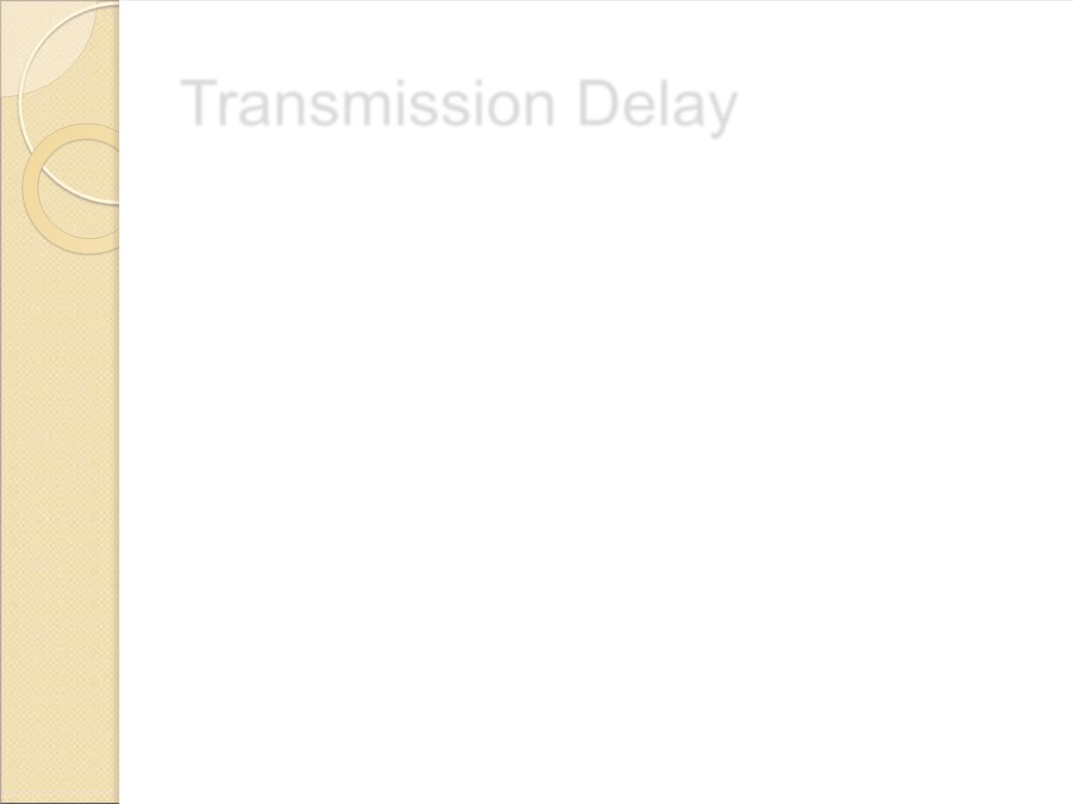
Transmission Delay
 Time taken to put a packet onto link. In other
words, it is simply time required to put data bits
on the wire/communication medium. It depends
on length of packet and bandwidth of network.
 Transmission Delay = Data size / bandwidth =
(L/B) second
25

Slide 24
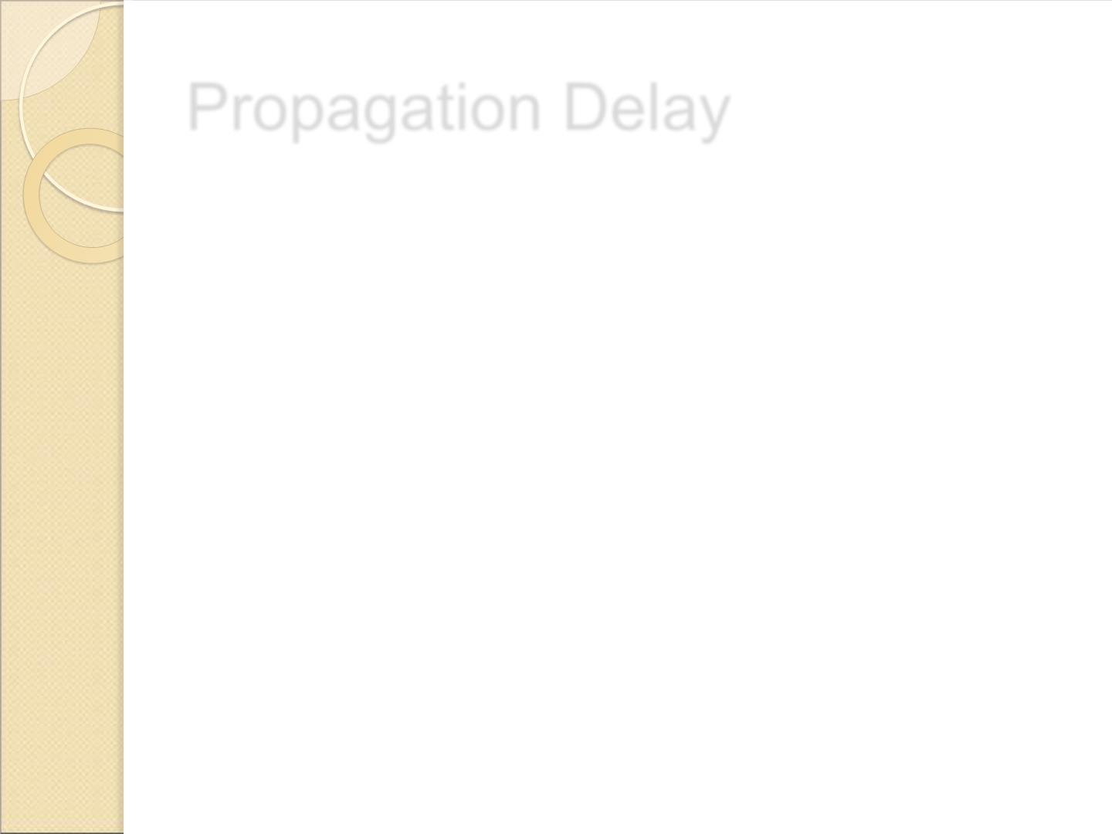
Propagation Delay
 Time taken by the first bit to travel from sender to
receiver end of the link. In other words, it is simply the
time required for bits to reach the destination from the
start point. Factors on which Propagation delay depends
are Distance and propagation speed.
 Propagation delay = distance/transmission speed = d/s
26

Slide 25
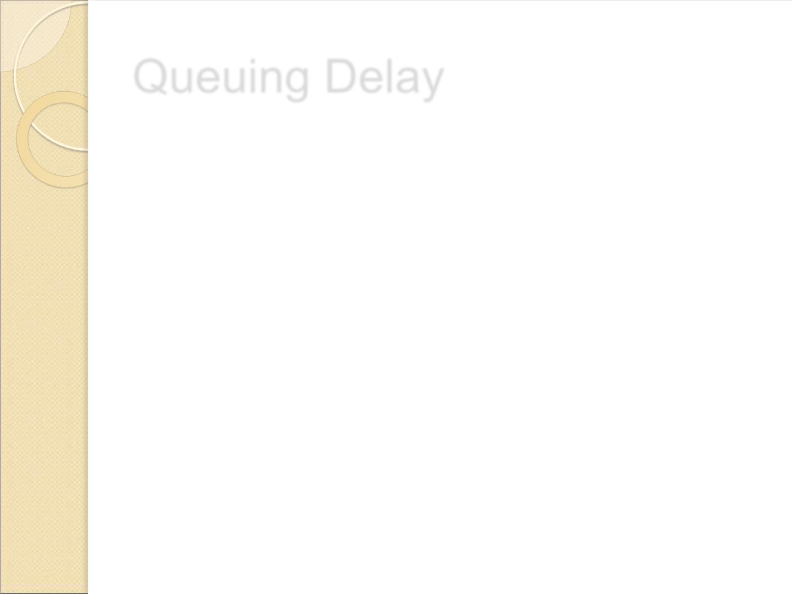
Queuing Delay
 Queuing delay is the time a job waits in a queue until
it can be executed.
 It depends on congestion. It is the time difference
between when the packet arrived Destination and
when the packet data was processed or executed.
 It may be caused by mainly three reasons i.e.
originating switches, intermediate switches or call
receiver servicing switches.
Average Queuing delay = (N-1)L/(2*R)
where N = no. of packets
L=size of packet
R=bandwidth
27

Slide 26

Processing Delay
 Processing delay is the time it takes routers to process
the packet header.
 Processing of packets helps in detecting bit-level errors
that occur during transmission of a packet to the
destination. Processing delays in high-speed routers are
typically on the order of microseconds or less.
 In simple words, it is just the time taken to process
packets.
28

Slide 27
Processing Delay
Total time or End-to-End time
= Transmission delay + Propagation delay+ Queuing delay
+ Processing delay
For M hops and N packets –
Total delay
= M*(Transmission delay + propagation delay)+
(M-1)*(Processing delay + Queuing delay) +
(N-1)*(Transmission delay)
For N connecting link in the circuit –
Transmission delay = N*L/R
Propagation delay = N*(d/s)
29

Slide 28

Problem
How much time will it take to send a packet of size L
bits from A to B in given setup if Bandwidth is R bps,
propagation speed is t meter/sec and distance b/w any
two points is d meters (ignore processing and queuing
delay) ?
A---R1---R2---B
Ans:
N = no. of links = no. of hops = no. of routers +1 = 3
File size = L bits
Bandwidth = R bps
Propagation speed = t meter/sec
Distance = d meters
Transmission delay = (N*L)/R = (3*L)/R sec
Propagation delay = N*(d/t) = (3*d)/t sec
Total time = 3*(L/R + d/t) sec
30

Slide 29
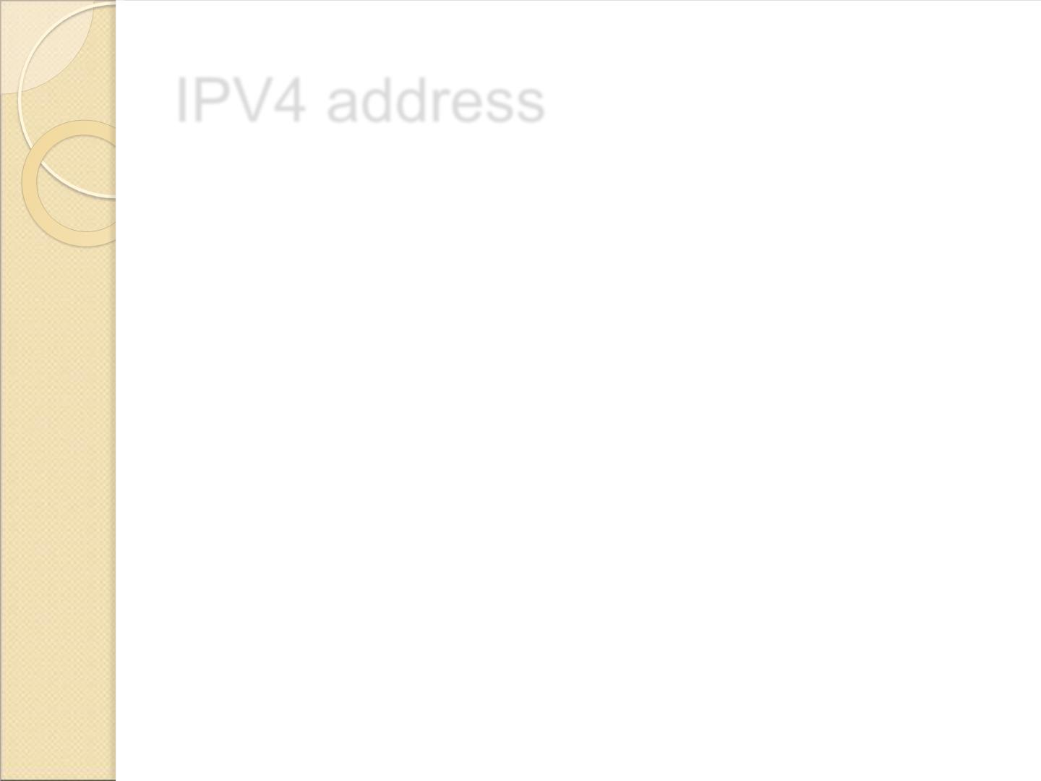
IPV4 address
 An IP address (internet protocol address) is a numerical
representation that uniquely identifies a specific
interface on the network.
 Addresses in IPv4 are 32-bits long. This allows for a
maximum of 4,294,967,296 (2³²) unique addresses.
 Addresses in IPv6 are 128-bits, which allows for 3.4 x
10³⁸ (2¹²⁸) unique addresses.
31

Slide 30
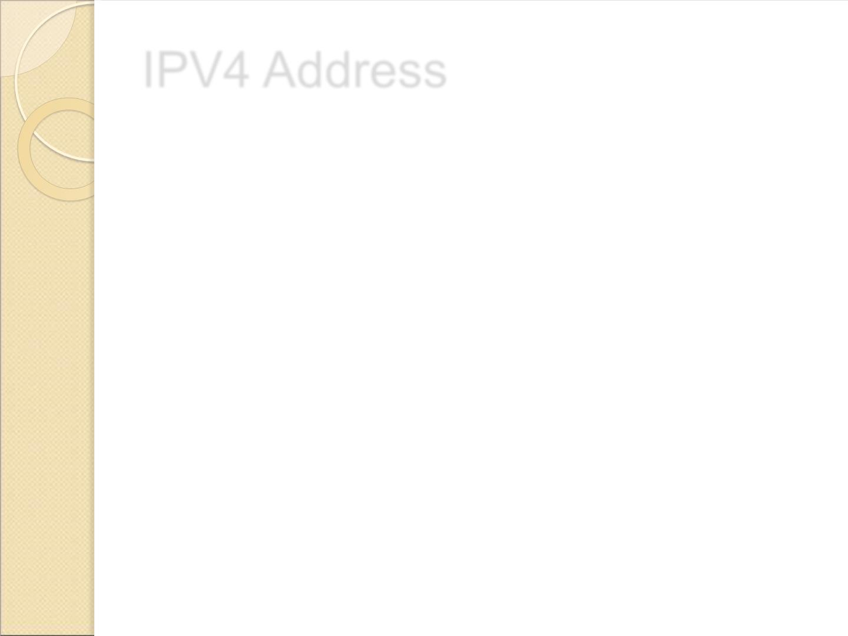
IPV4 Address
 IP addresses are binary numbers but are typically
expressed in decimal form (IPv4) or hexadecimal form
(IPv6) to make reading and using them easier for
humans.
 IP stands for Internet Protocol and describes a set of
standards and requirements for creating and
transmitting data packets, or datagrams, across
networks.
 The Internet Protocol (IP) is part of the Internet layer of
the Internet protocol suite. In the OSI model, IP would
be considered part of the network layer.
 IP is traditionally used in conjunction with a higher-level
protocol, most notably TCP. The IP standard is governed
by RFC 791.
32

Slide 31
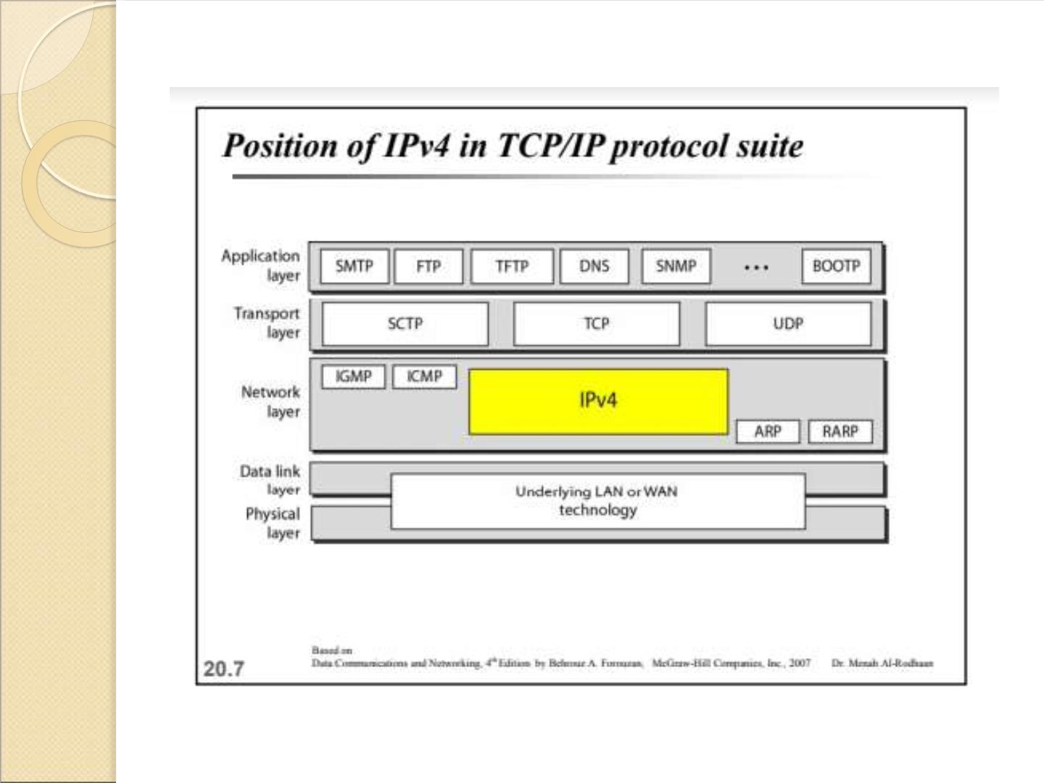
33

Slide 32
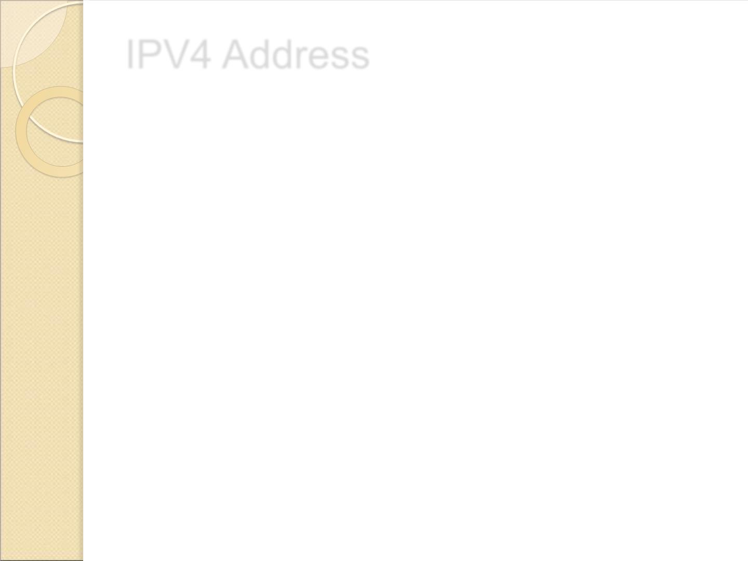
IPV4 Address
 IPv4 addresses are actually 32-bit binary numbers,
consisting of the two sub addresses (identifiers)
mentioned above which, respectively, identify the
network and the host to the network, with an
imaginary boundary separating the two.
 An IP address is, as such, generally shown as 4 octets of
numbers from 0-255 represented in decimal form instead
of binary form.
 An IPv4 address is typically expressed in dotted-
decimal notation, with every eight bits (octet)
represented by a number from one to 255, each
separated by a dot.
 An example IPv4 address would look like this:
192.168.17.12
34

Slide 33
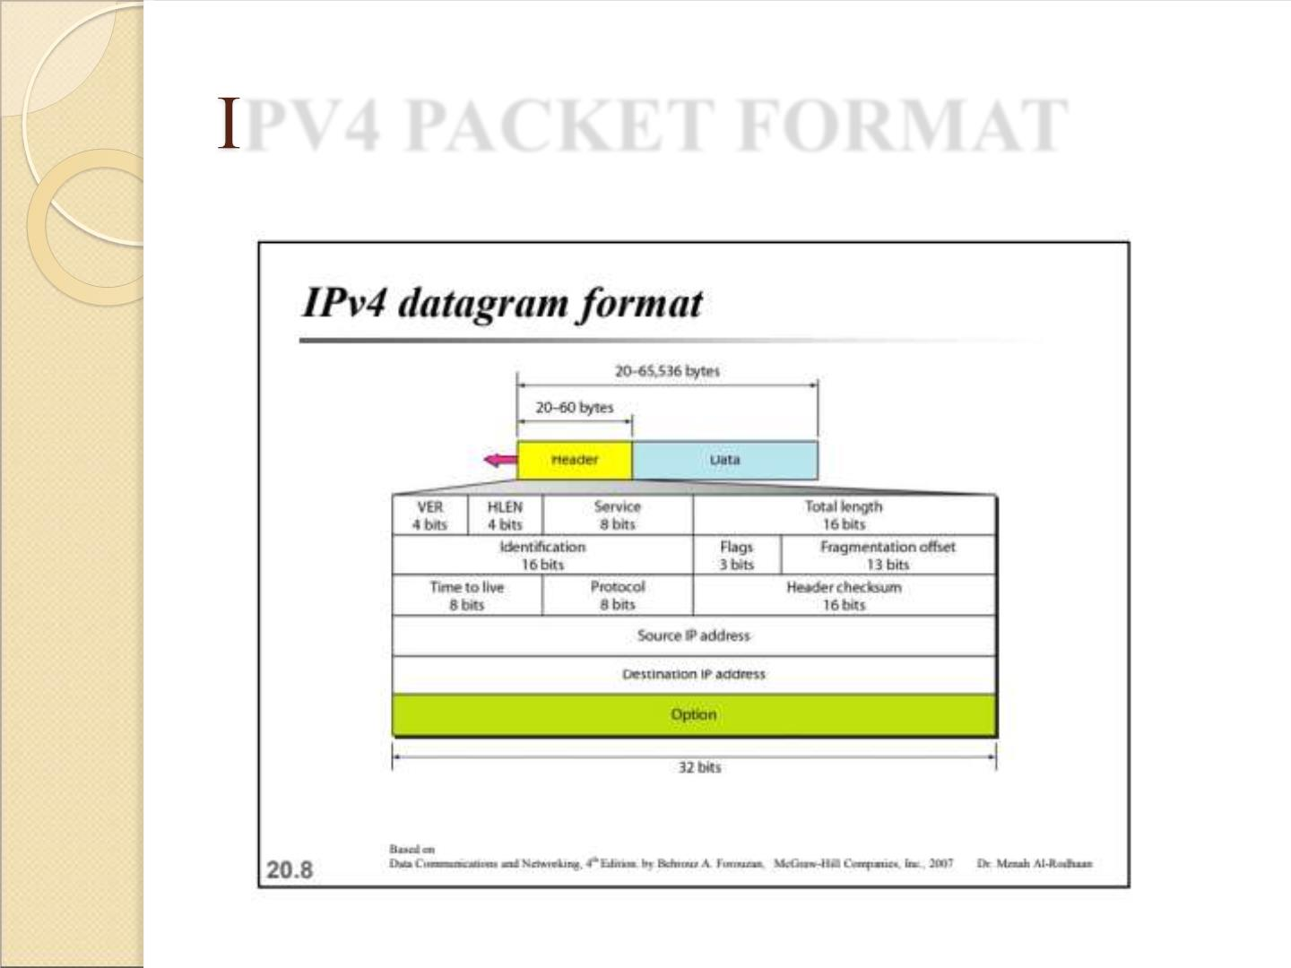
PV4 PACKET FORMAT

Slide 34
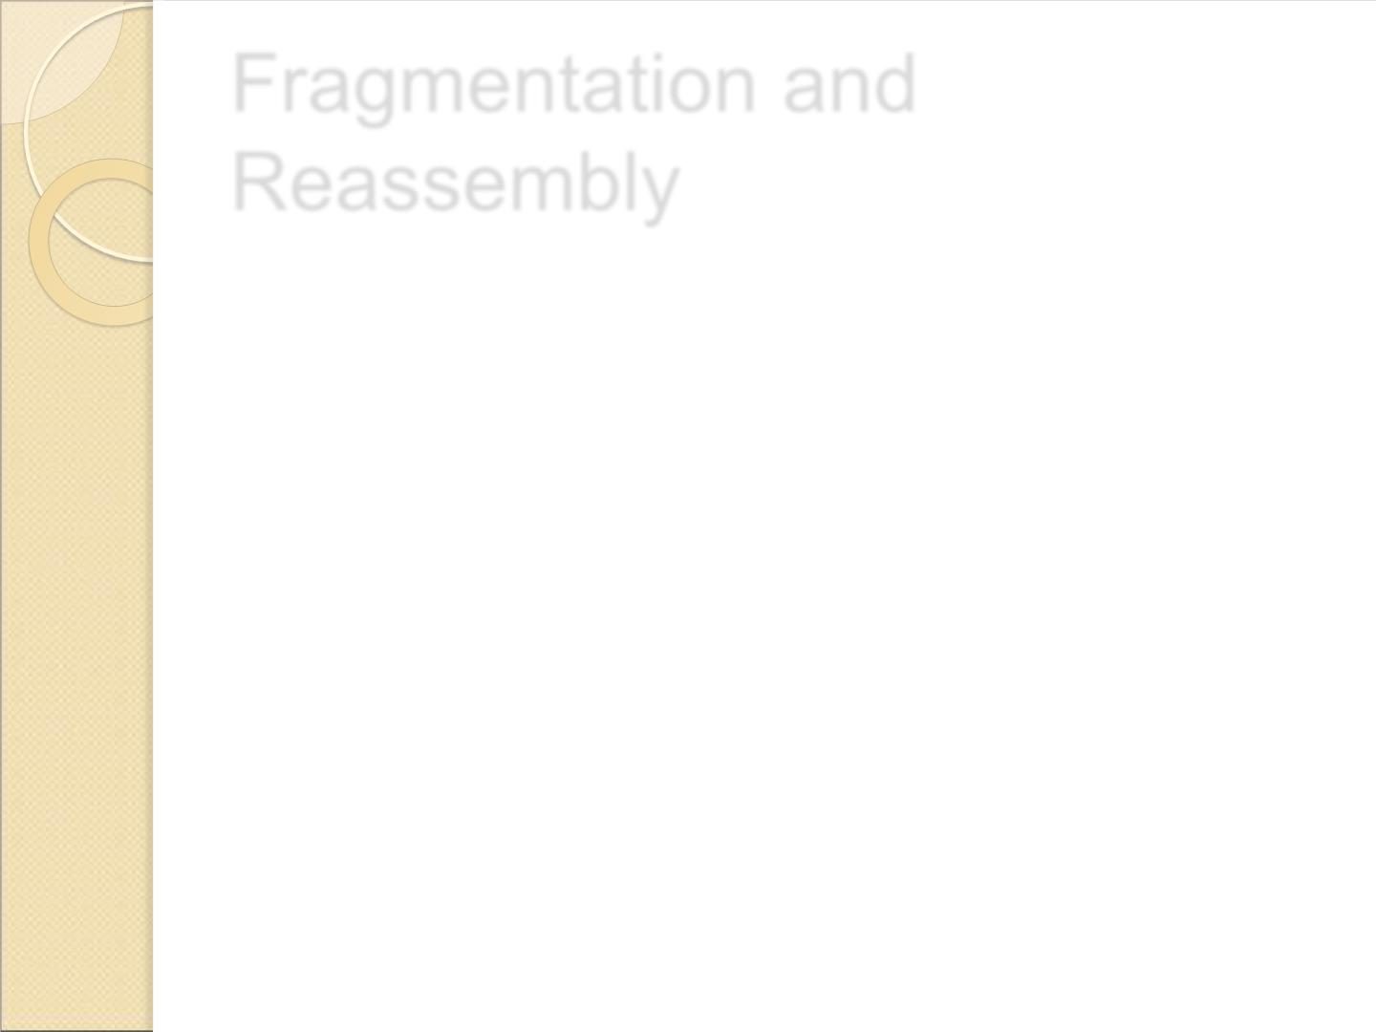
Fragmentation and
Reassembly
 Fragmentation and reassembly is a
method for transmission of messages
larger than networks Maximum
Transmission Unit (MTU).
 Messages are fragmented into small
pieces by the sender and
reassembled by the receiver.
36

Slide 35
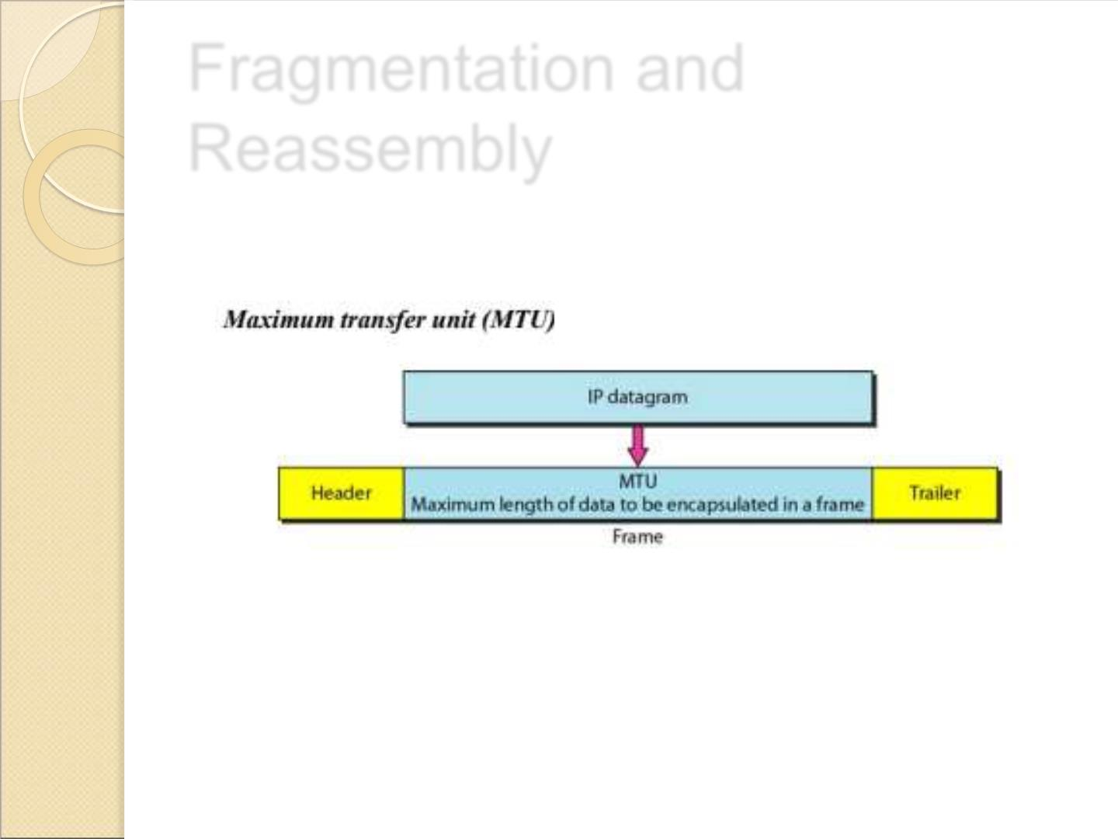
Fragmentation and
Reassembly
37

Slide 36
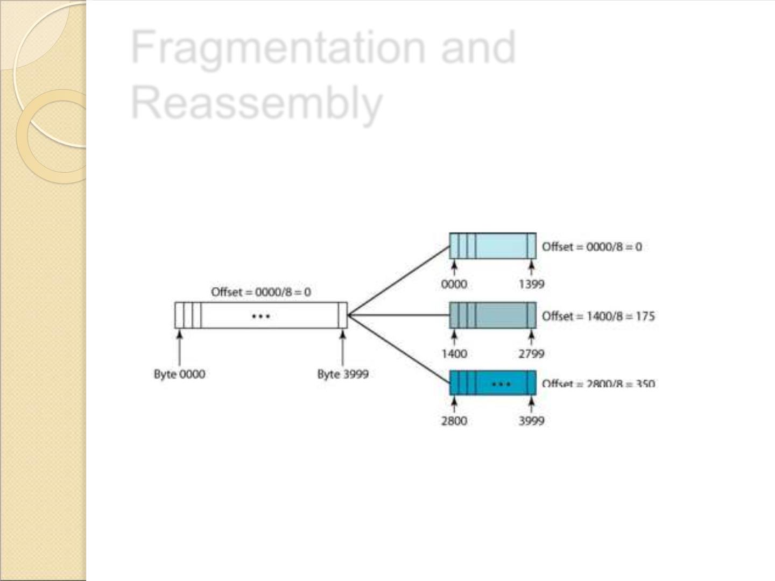
Fragmentation and
Reassembly
38

Slide 37

Global Address
 The term IP address is used to mean
a logical address in the network layer
and is used in the Source address and
Destination address field of the IP
packets.
39

Slide 38
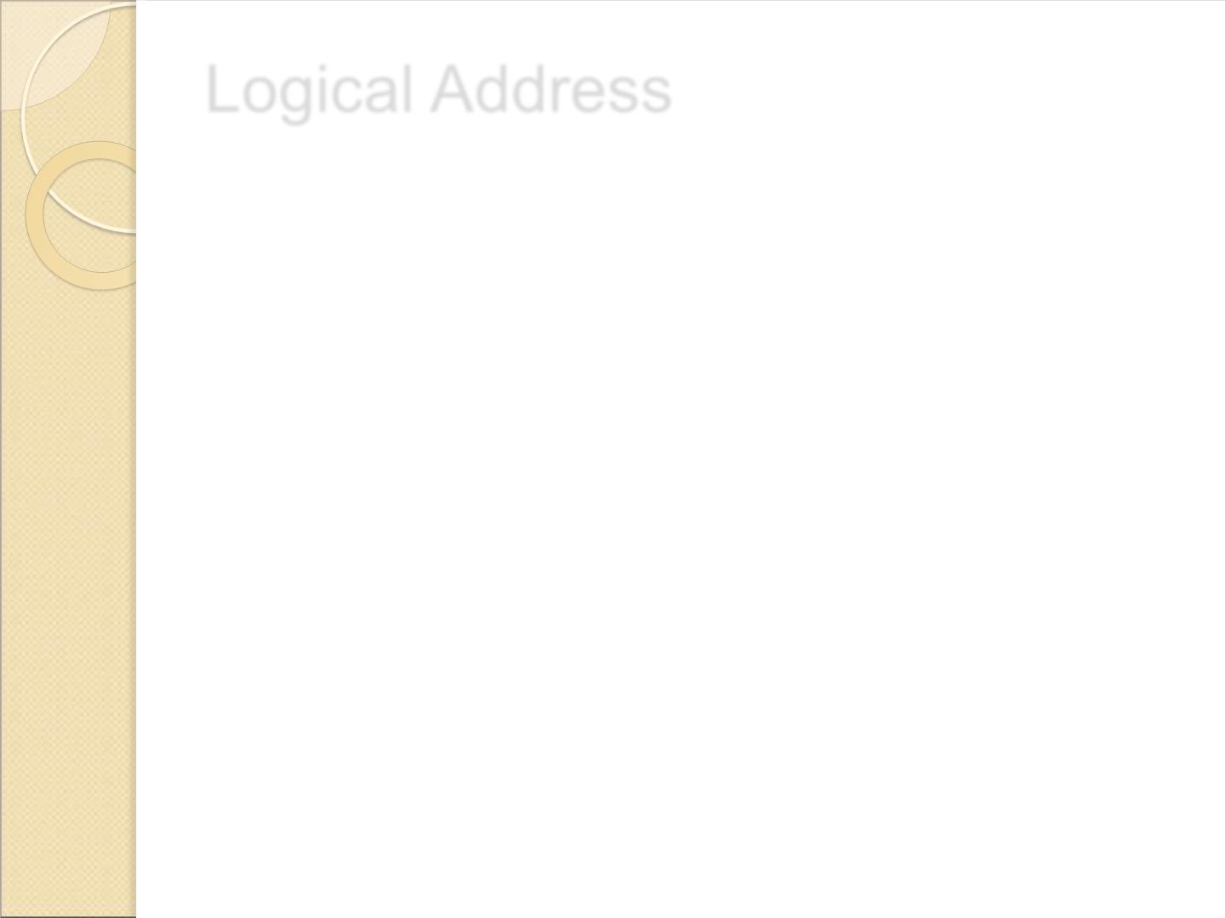
Logical Address
 Logical address are necessary for universal
communications to identify each host in the
internet for delivery of a packet from host to
host.
 All IPv4 addresses are 32 bits long
( equivalently 4 bytes).
 Within an IP address it encodes its network
number and host number.
 The physical (network) addresses will change
from hop to hop, but the logical addresses
remains the same.
40

Slide 39
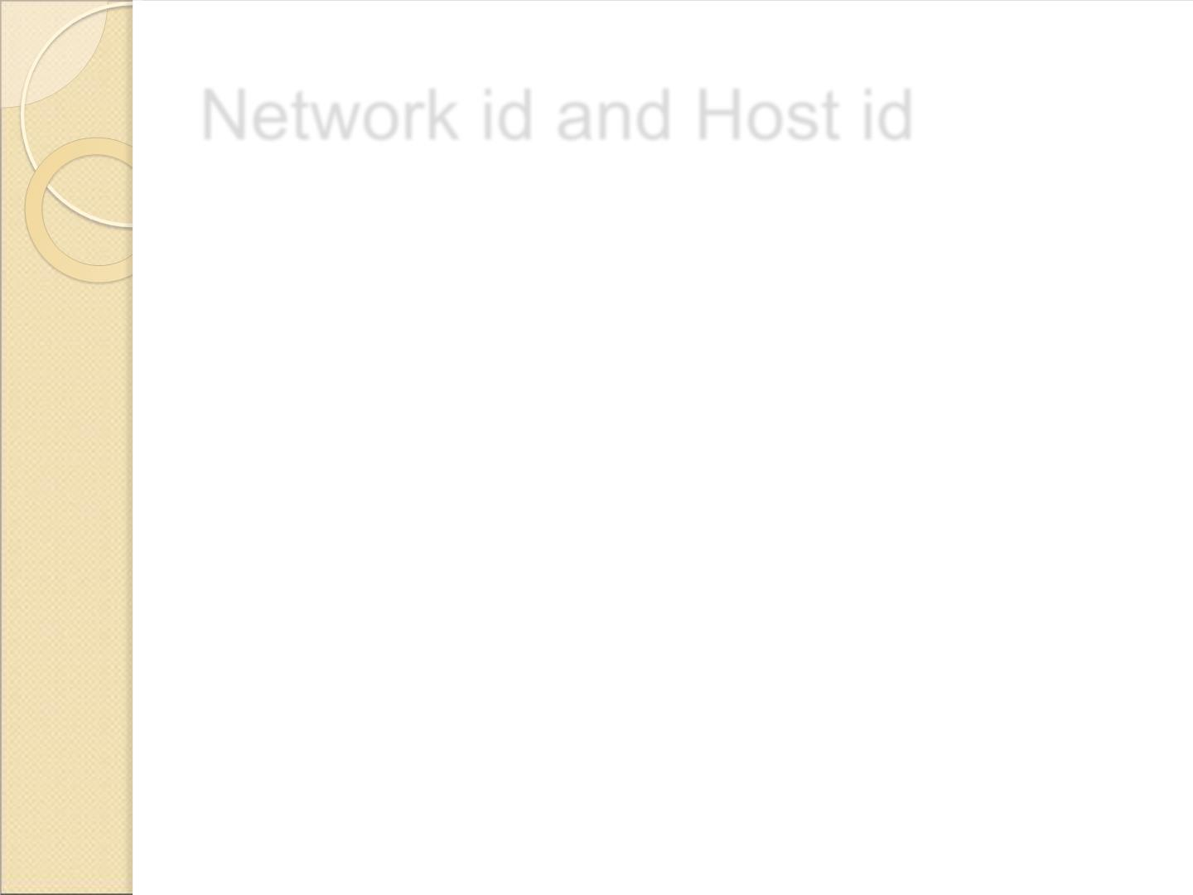
Network id and Host id
 Network ID is the portion of an IP address that identifies the
TCP/IP network on which a host resides.
 The network ID portion of an IP address uniquely identifies
the host’s network on an internetwork, while the host ID
portion of the IP address identifies the host within its
network.
 Together, the host ID and network ID, which make up the
entire IP address of a host, uniquely identify the host on a
TCP/IP internetwork.
41

Slide 40
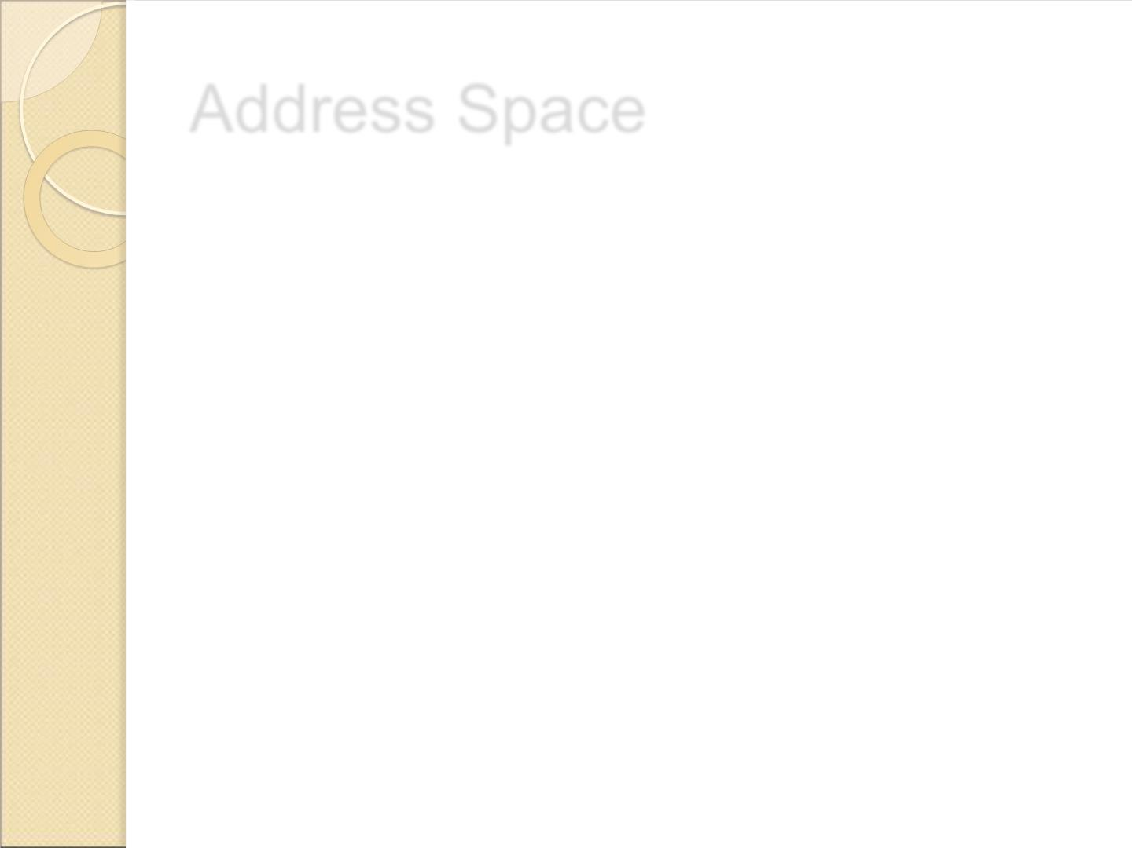
Address Space
 An address space is the total number
of addresses used by the protocol.
 For an N bits address, 2^{N bits address}
space can be used, because each bit
can have two different values (0 or 1).
42

Slide 41
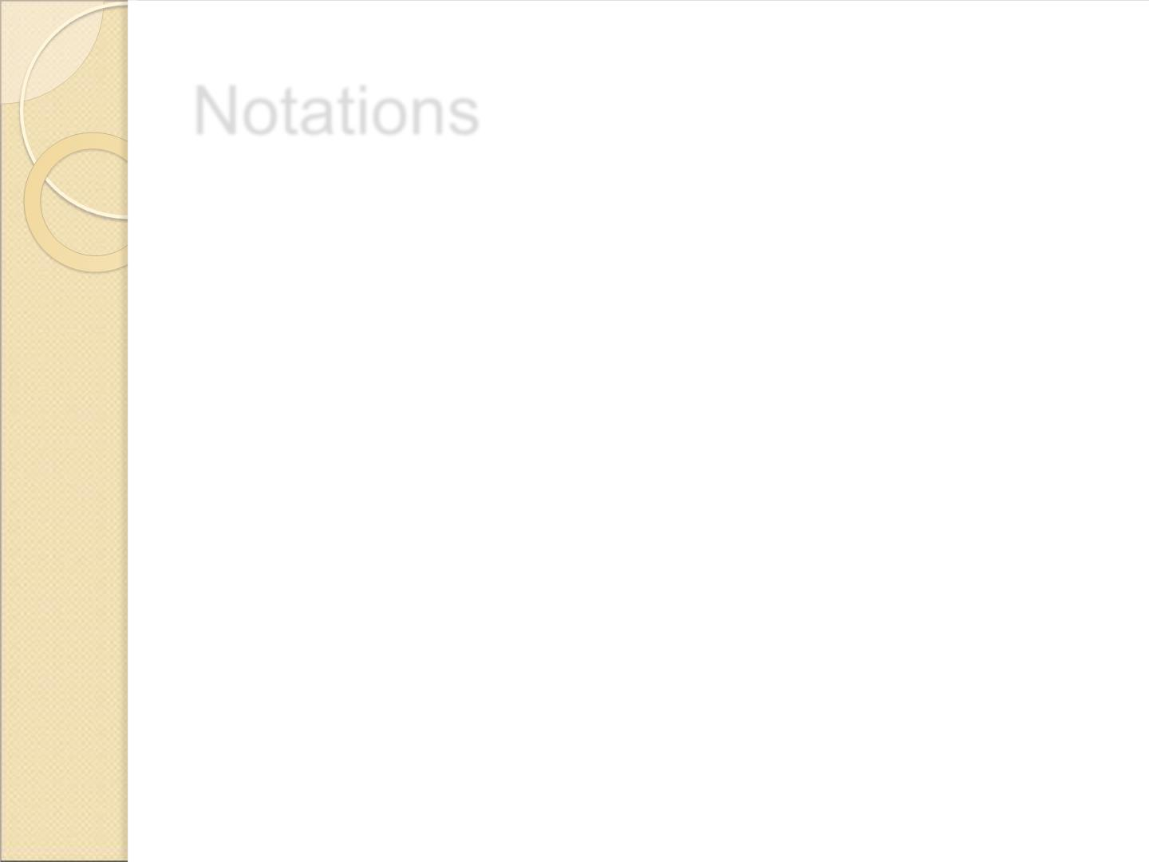
Notations
 Two types of notations in IPv4.
1. Binary Notation
2. Dotted- Decimal Notation
43

Slide 42
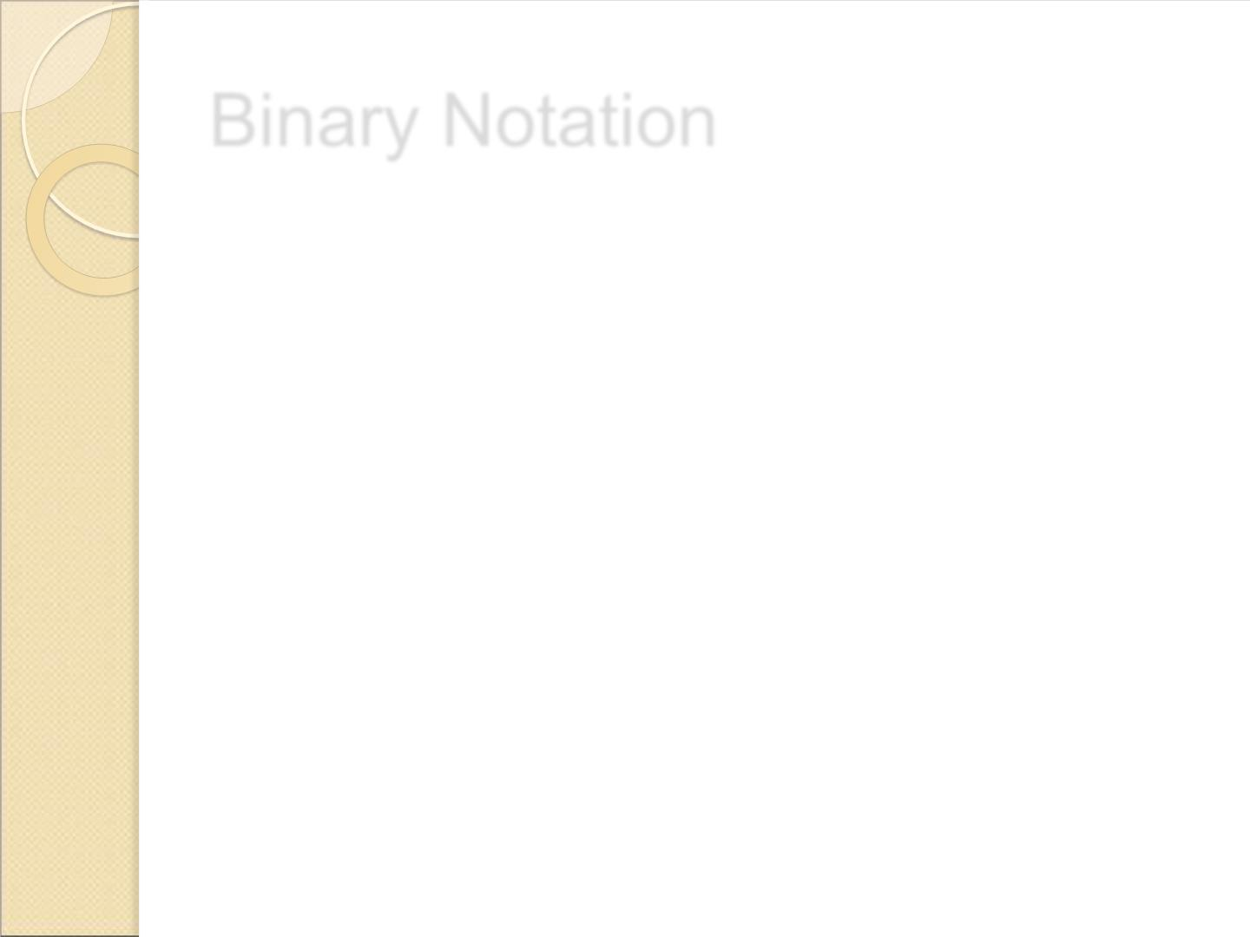
Binary Notation
 The binary notation in IPv4 is a 32 bit
address or 4 bytes addres.
Ex;
01000000 00100000 00010000
00000111
44

Slide 43

Dotte Decima Notation
 To make 32 bit form shorter and easier
to read, Internet addresses are usually
written in Decimal form with decimal
points separating the bytes called as
Dotted decimal notation.
 Each number varies from 0 to 255.
Example:
01000000 00100000 00010000
00000111
64
32
16
7
45

Slide 44
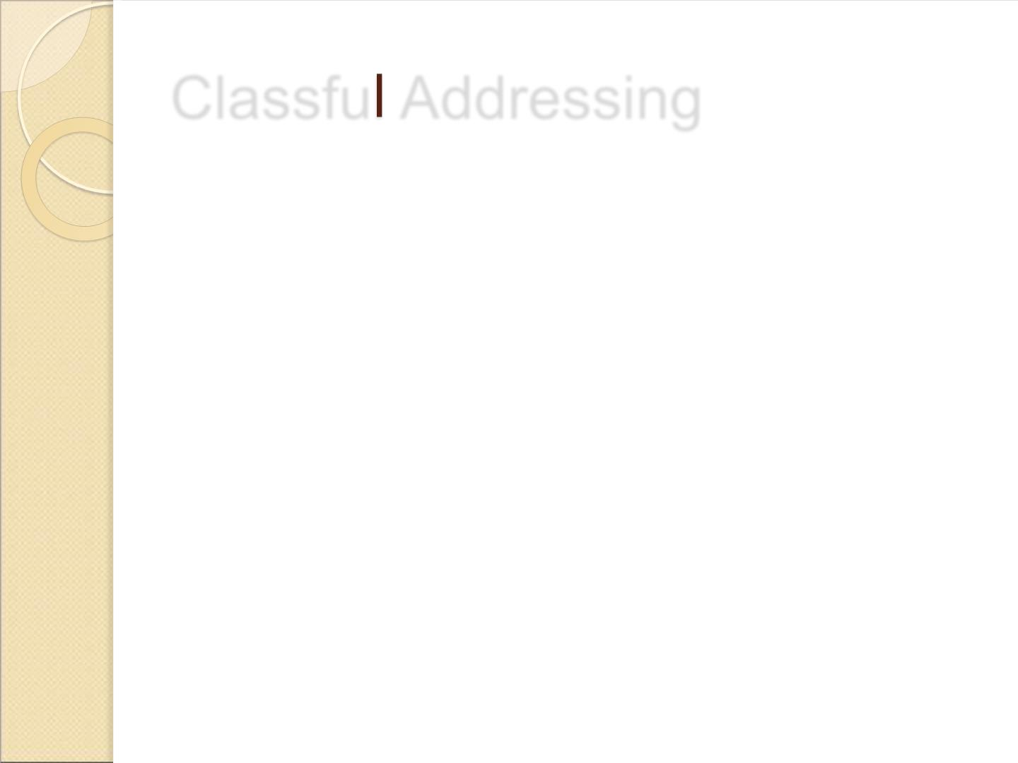
Classfu Addressing
 IPv4 addresses were divided into 5
categories.
◦ Class A
◦ Class B
◦ Class C
◦ Class D
◦ Class E
 This allocation has come to be called
classful addressing
46

Slide 45
Classfu Addressing
 IPv4 address of 4 bytes defines 3
fields.
➢Class Type
➢Network ID(Netid)
➢HostID
47

Slide 46
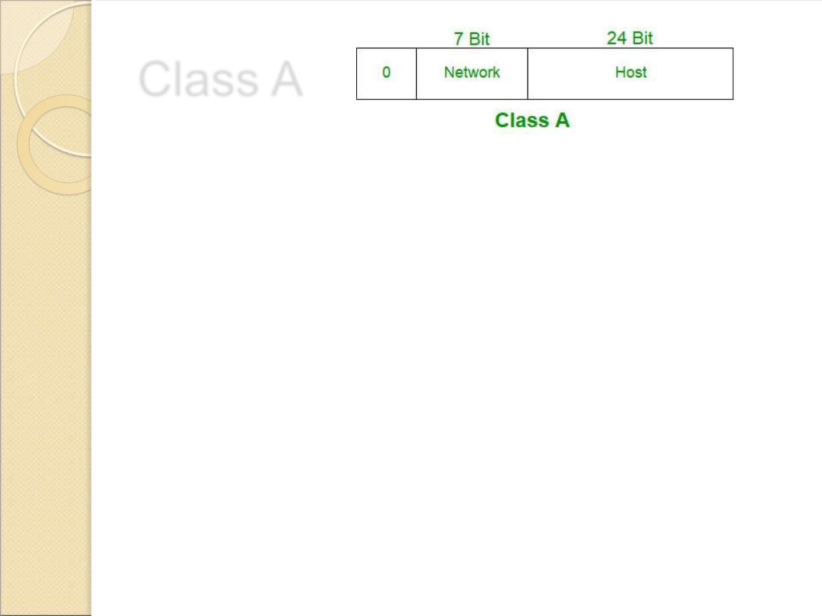
Class A
 Class A addresses were designed for large organizations with
a large number of attached hosts or routers.
 In a Class A network, the first eight bits, or the first dotted
decimal, is the network part of the address, with the
remaining part of the address being the host part of the
address. There are 128 possible Class A networks.
0.0.0.0 to 127.0.0.0
 However, any address that begins with 127. is considered a
loopback address.
48

Slide 47
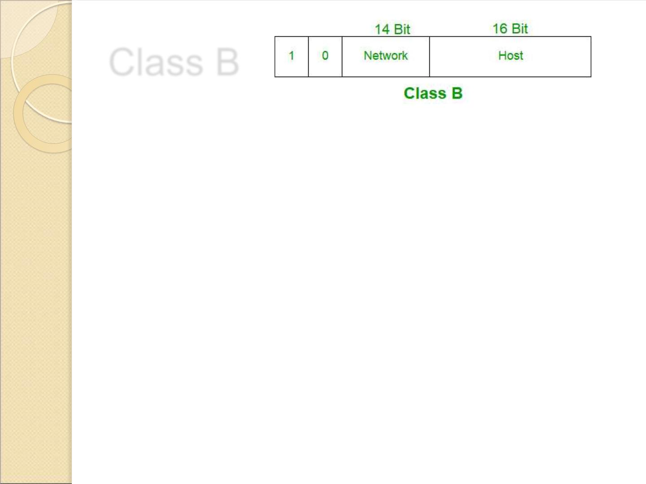
Class B
 Class B addresses were designed for midsize organizations with tens of
thousands of attached hosts or routers.
 In a Class B network, 2 bytes for class type and netid and 2 bytes for
hosted.
 All Class B networks have their first bit set to 1 and the second bit set
to 0.
 In dotted decimal notation, that makes 128.0.0.0 to 191.255.0.0 as
Class B networks.
 There are 16,384 possible Class B networks.
 Example for a Class B IP address:
135.168.24.14
49

Slide 48
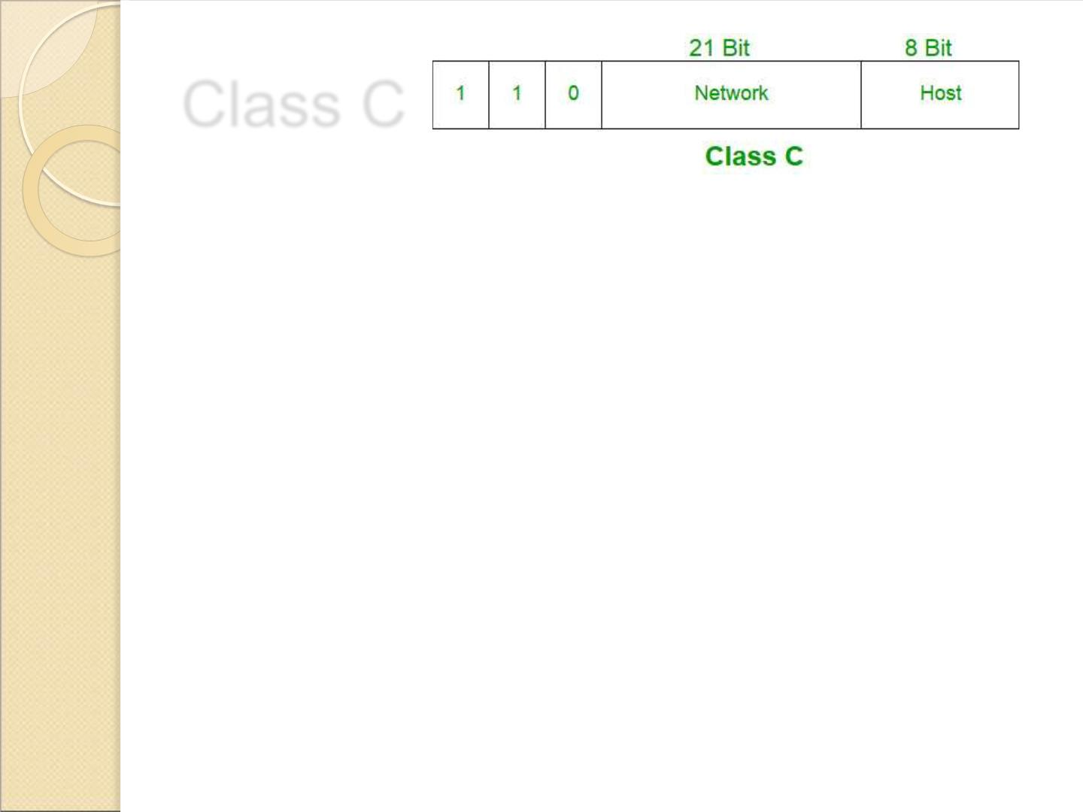
Class C
 Class C addresses were designed for small organizations with a
small number of attached hosts or routers.
 It uses 3 bytes for class type and netid and 1 byte for hostid.
 In a Class C network, the first two bits are set to 1, and the third bit
is set to 0.
 That makes the first 24 bits of the address the network address and
the remainder as the host address.
 Class C network addresses range from 192.0.0.0 to 223.255.255.0.
There are over 2 million possible Class C networks.
192.168.178.1
50

Slide 49
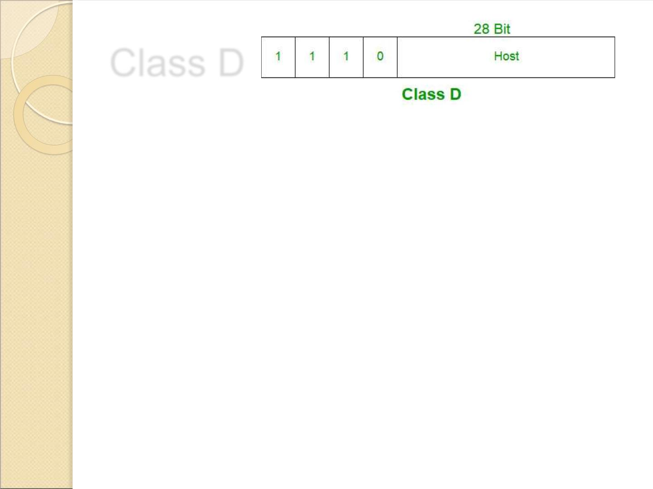
Class D
 Class D addresses are used for multicasting applications.
 Class D addresses have their first three bits set to “1”
and their fourth bit set to “0”.
 Class D addresses are 32-bit network addresses,
meaning that all the values within the range of 224.0.0.0
– 239.255.255.255 are used to uniquely identify
multicast groups.
 There are no host addresses within the Class D address
space, since all the hosts within a group share the
group’s IP address for receiver purposes.
227.16.6.176
51

Slide 50

Class E
 Class E addresses are reserved for future use, in which
addresses beginning with 1111.
 Class E networks are defined by having the first four
network address bits as 1.
 That encompasses addresses from 240.0.0.0 to
255.255.255.255. While this class is reserved, its usage
was never defined.
 As a result, most network implementations discard these
addresses as illegal or undefined.
243.164.89.28
52

Slide 51
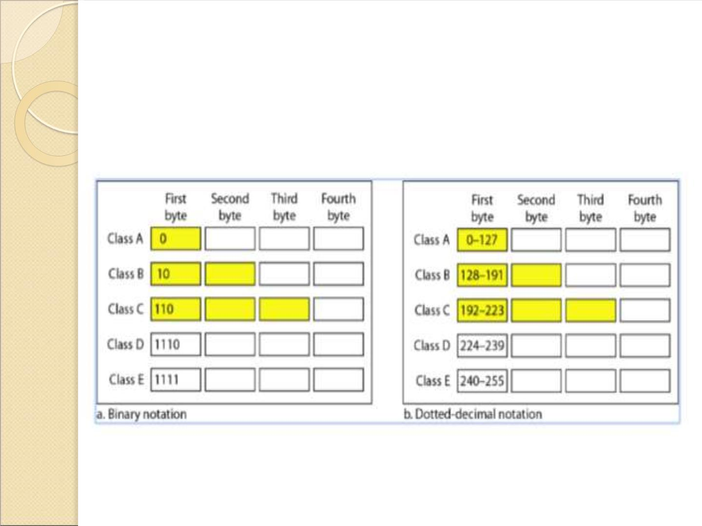
Classful Addressing
53

Slide 52
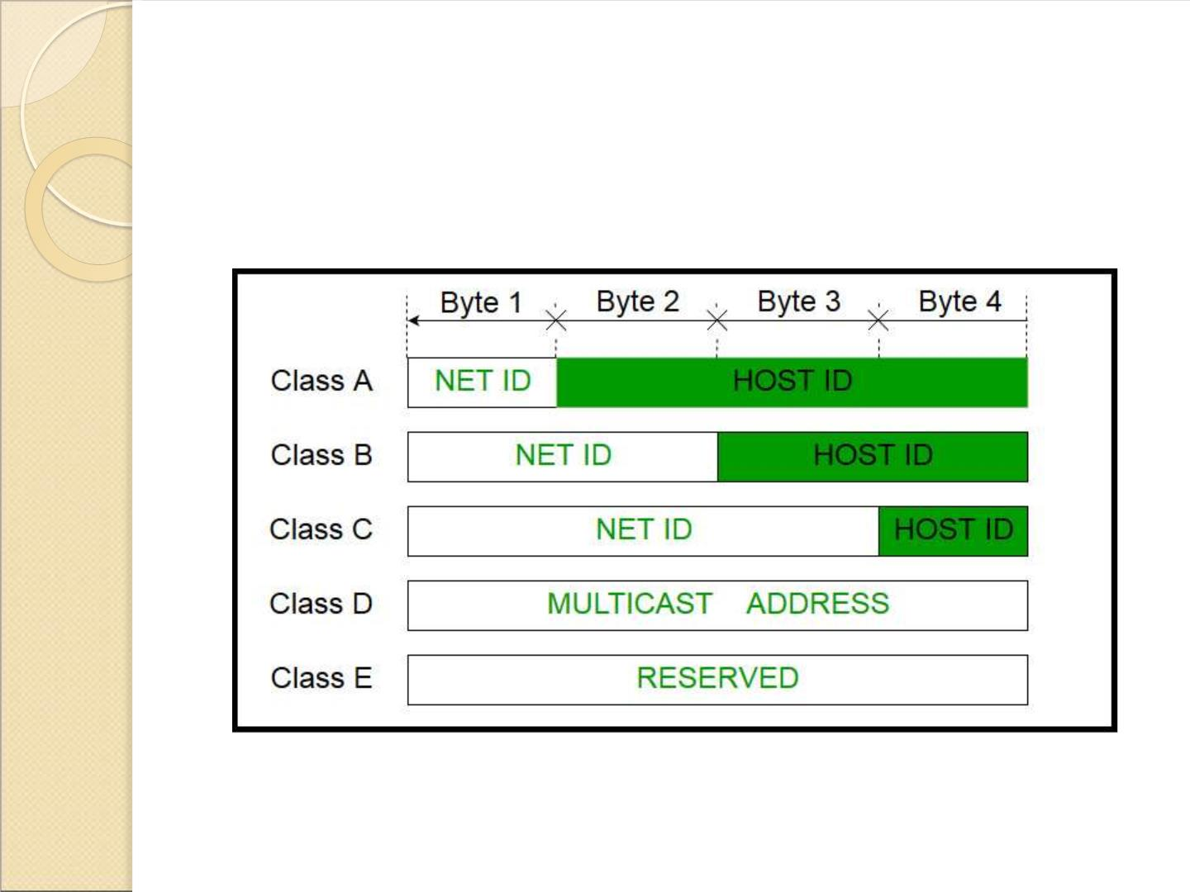
Classful Addressing
54

Slide 53
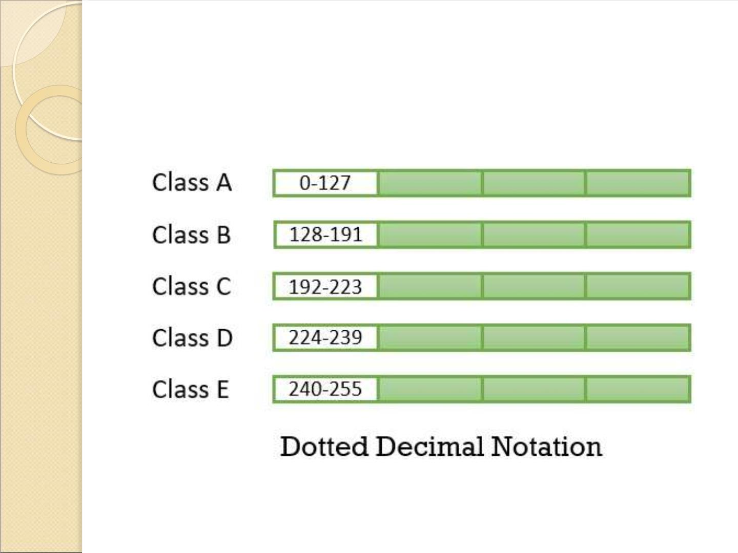
Classful Addressing
55

Slide 54
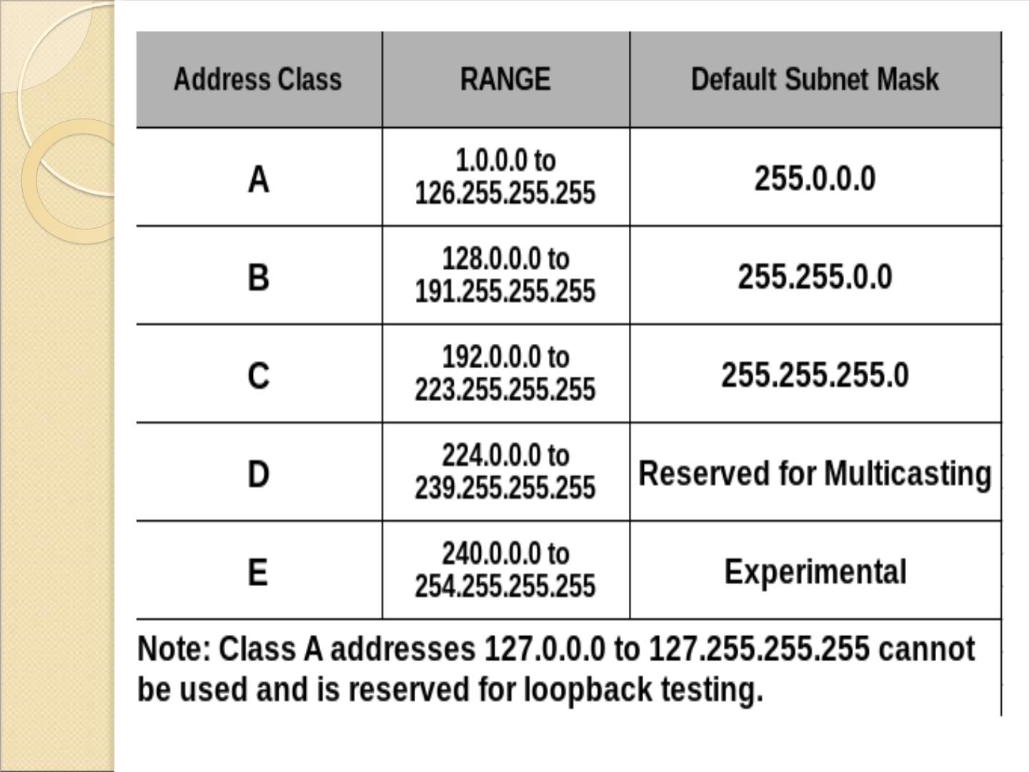
56

Slide 55
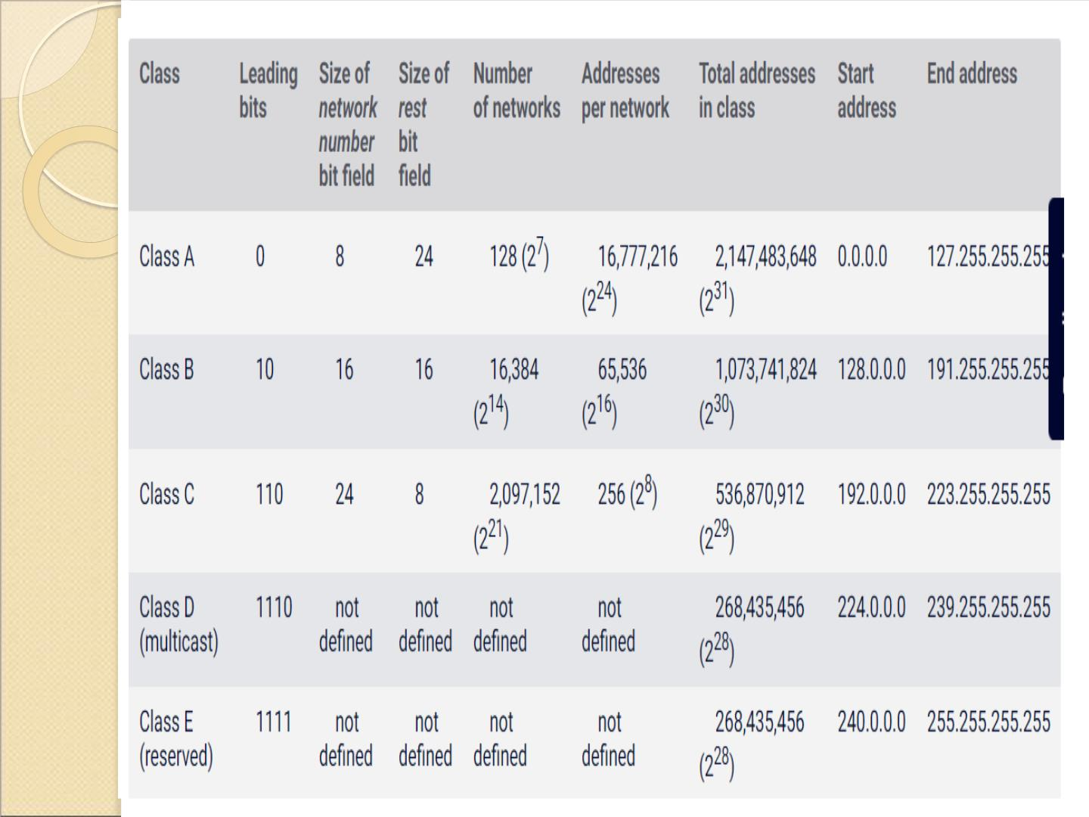
57

Slide 56
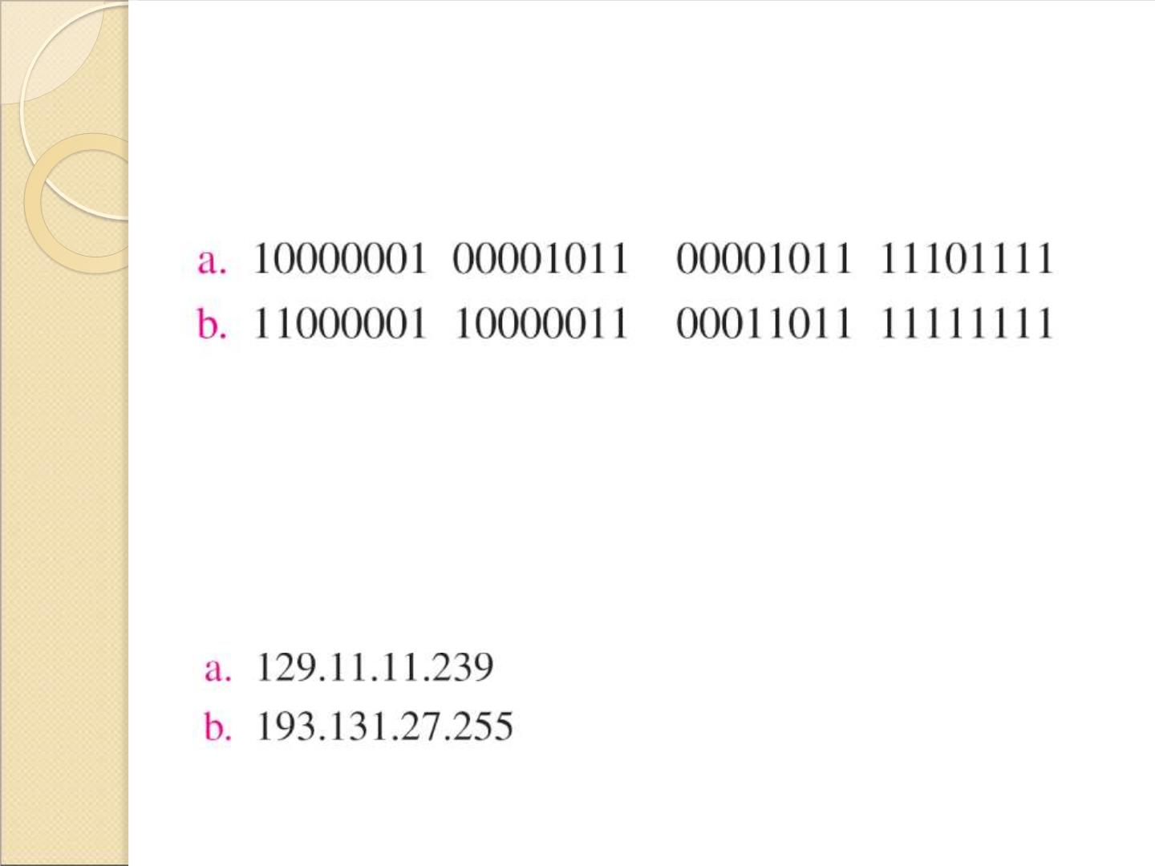
Change the following IPv4 addresses from binary notation to dotted-
decimal notation.
Solution
We replace each group of 8 bits with its equivalent decimal number (see
Appendix B) and add dots for separation.
58

Slide 57
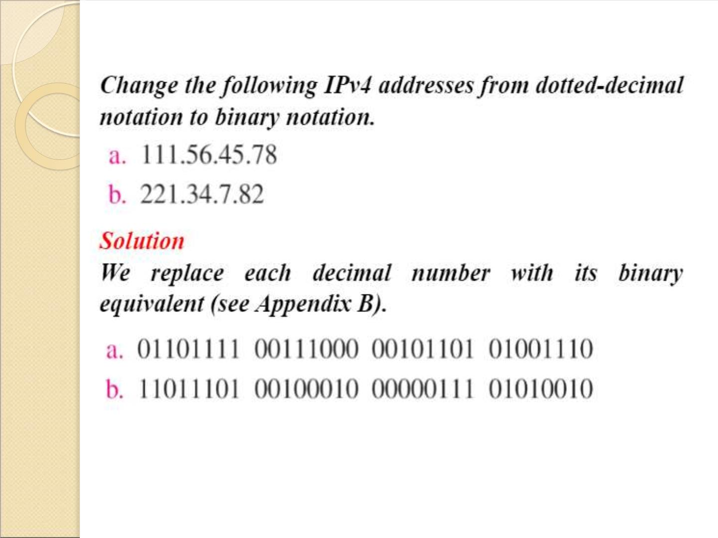
59

Slide 58
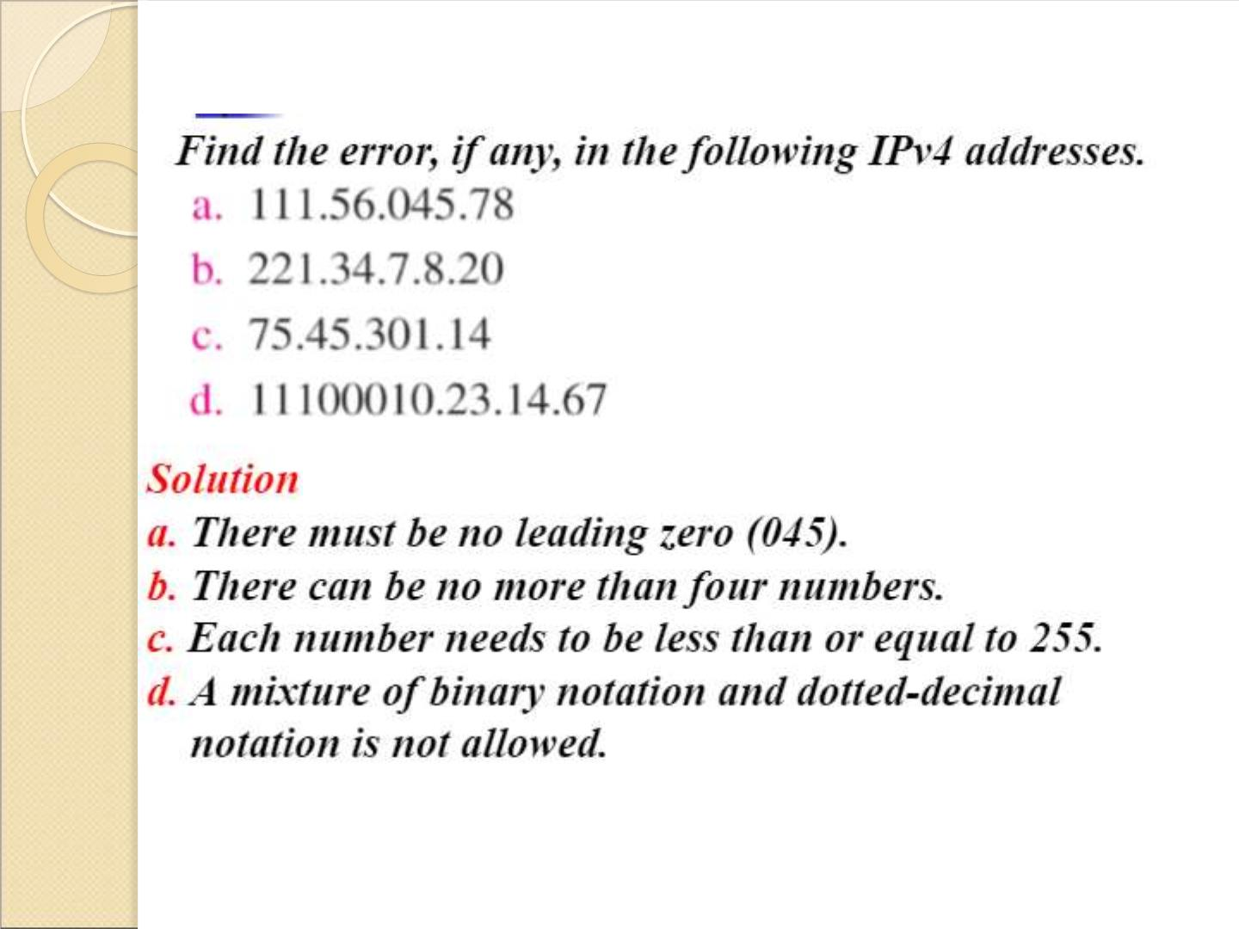
60

Slide 59
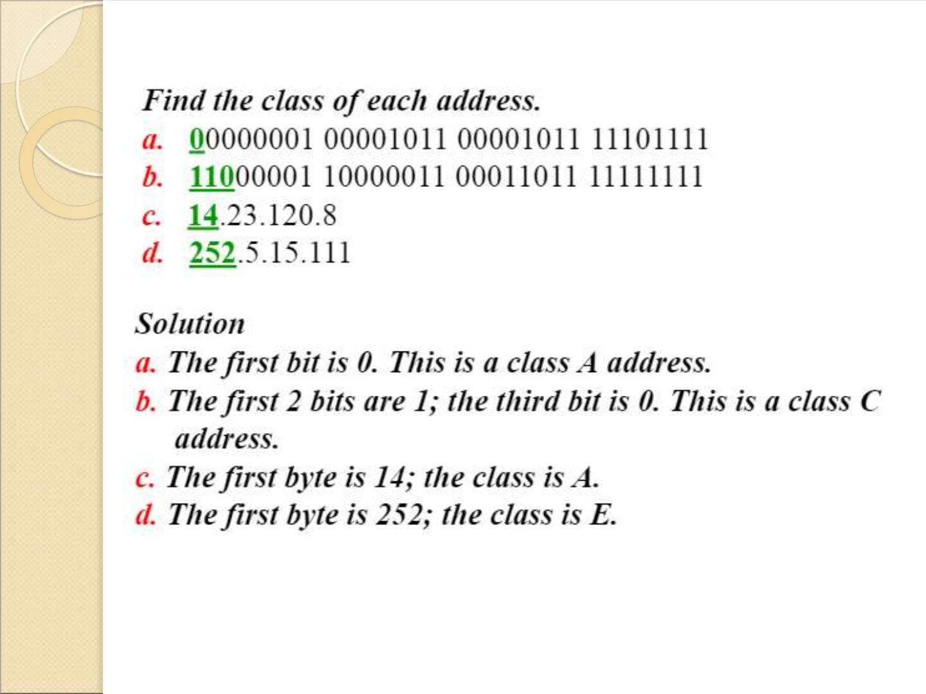
61

Slide 60

Disadvantages of Classful
Addressing
 If we consider class A, the number of addresses in each
block is more than enough for almost any
organization. So, it results in wastage of addresses.
 Same is the case with class B, probably an organization
receiving block from class B would not require that
much of addresses. So, it also results in wastage of
addresses.
 A block in class C may be too small to fulfil the
addresses requirement of an organization.
 Each address in class D defines a group of hosts. Hosts
need to multicast the address. So, the addresses are
wasted here too.
 Addresses of class E are reserved for the future
purpose which is also wastage of addresses.
 The main issue here is; we are not
assigning addresses according to user requirements.
We directly assign a block of a fixed size which has
a fixed number of addresses which leads to wastage
of address.
62

Slide 61
Subnetting and Supernetting
 To overcome the flaws of classful
addressing, these two solutions were
introduced to compensate for the
wastage of addresses.
 Let us discuss them one by one.
63

Slide 62
Subnetting
 As class blocks of A & B are too large for any
organization. So, they can divide their large network
in the smaller subnetwork and share them with
other organizations. This whole concept
is subnetting.
Supernetting
 As the blocks in class A and B were almost
consumed so, new organizations consider
class C. But, the block of class C is too small
then the requirement of the organization. In
this case, the solution which came out is
supernetting which grants to join the blocks
of class C to form a larger block which
satisfies the address requirement of the
organization.
64

Slide 63
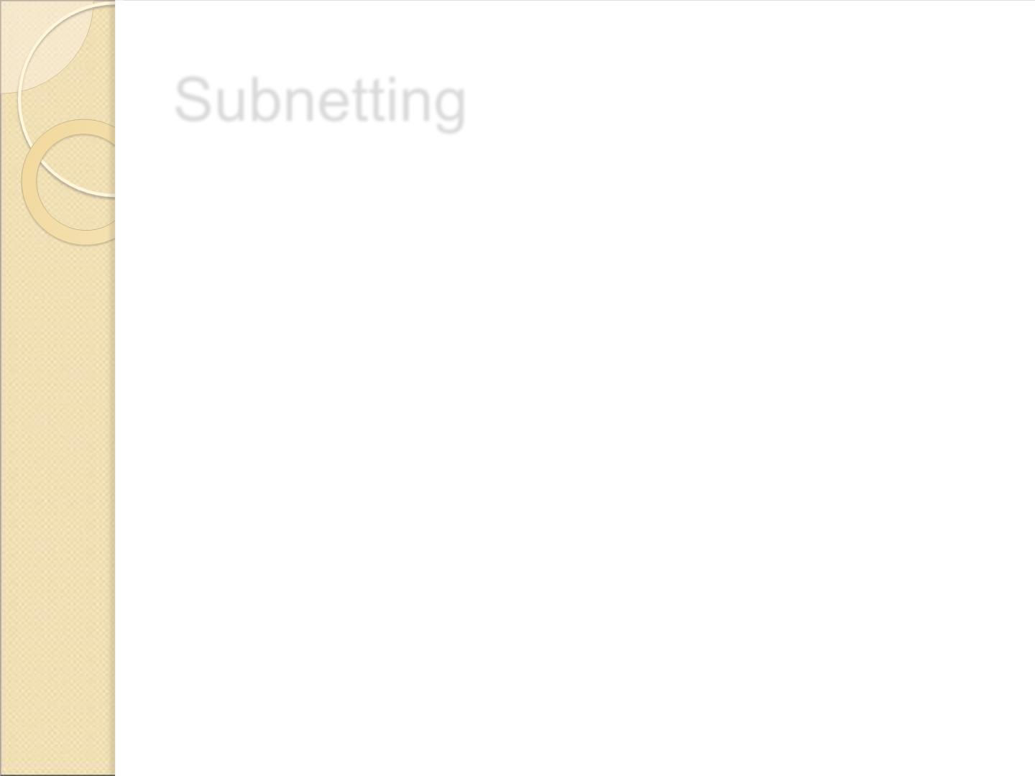
Subnetting
 A subnet, or subnetwork, is a segmented piece
of a larger network.
 More specifically, subnets are a logical partition
of an IP network into multiple, smaller network
segments.
 Organizations will use a subnet to subdivide
large networks into smaller, more efficient
subnetworks.
65

Slide 64
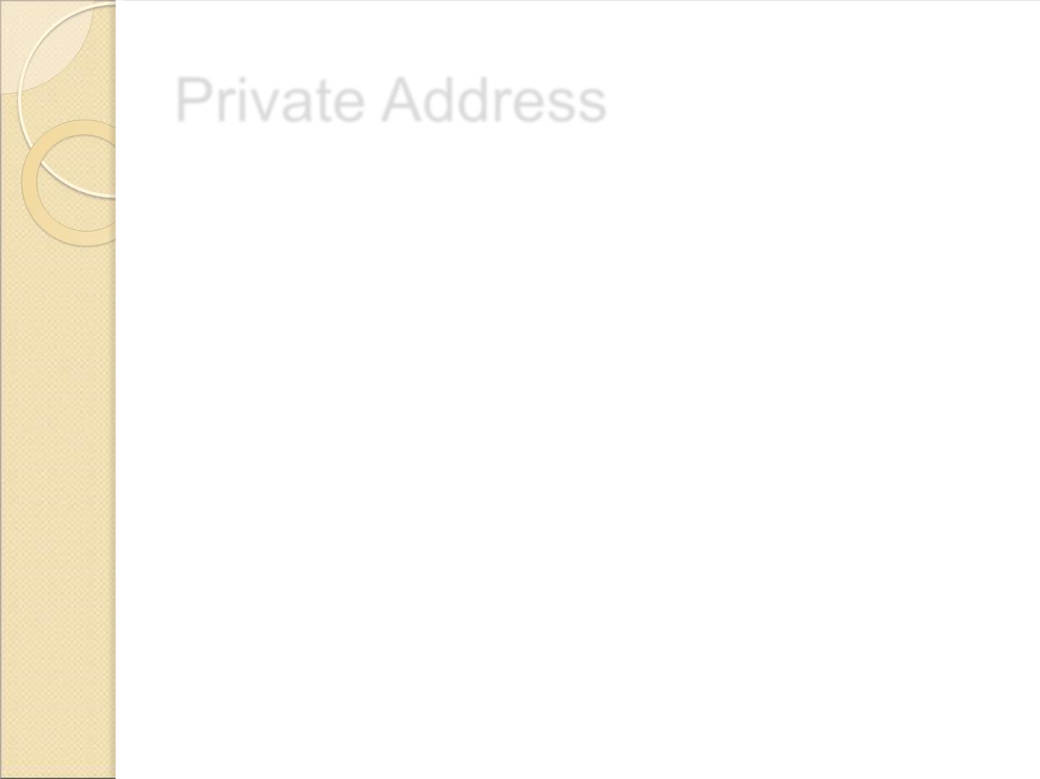
Private Address
 Within the address space, certain networks are reserved
for private networks.
 Packets from these networks are not routed across the
public internet. This provides a way for private networks
to use internal IP addresses without interfering with
other networks. The private networks are
10.0.0.1 - 10.255.255.255
172.16.0.0 - 172.32.255.255
192.168.0.0 - 192.168.255.255
66

Slide 65
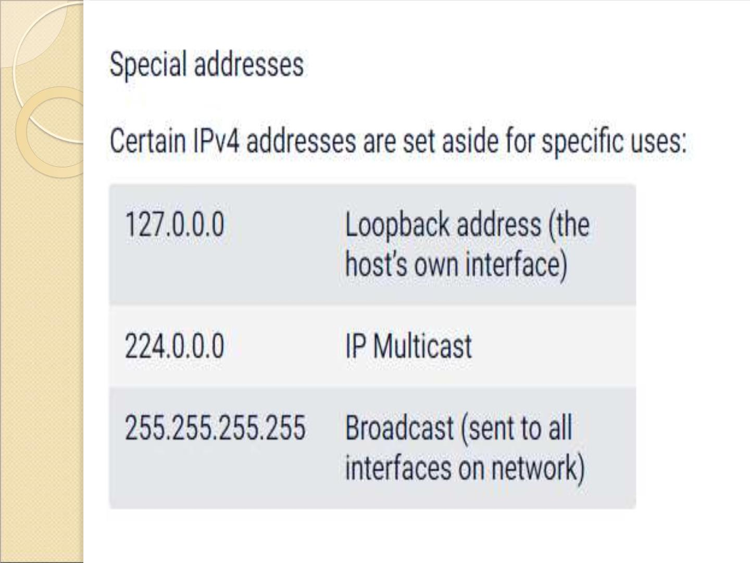
67

Slide 66
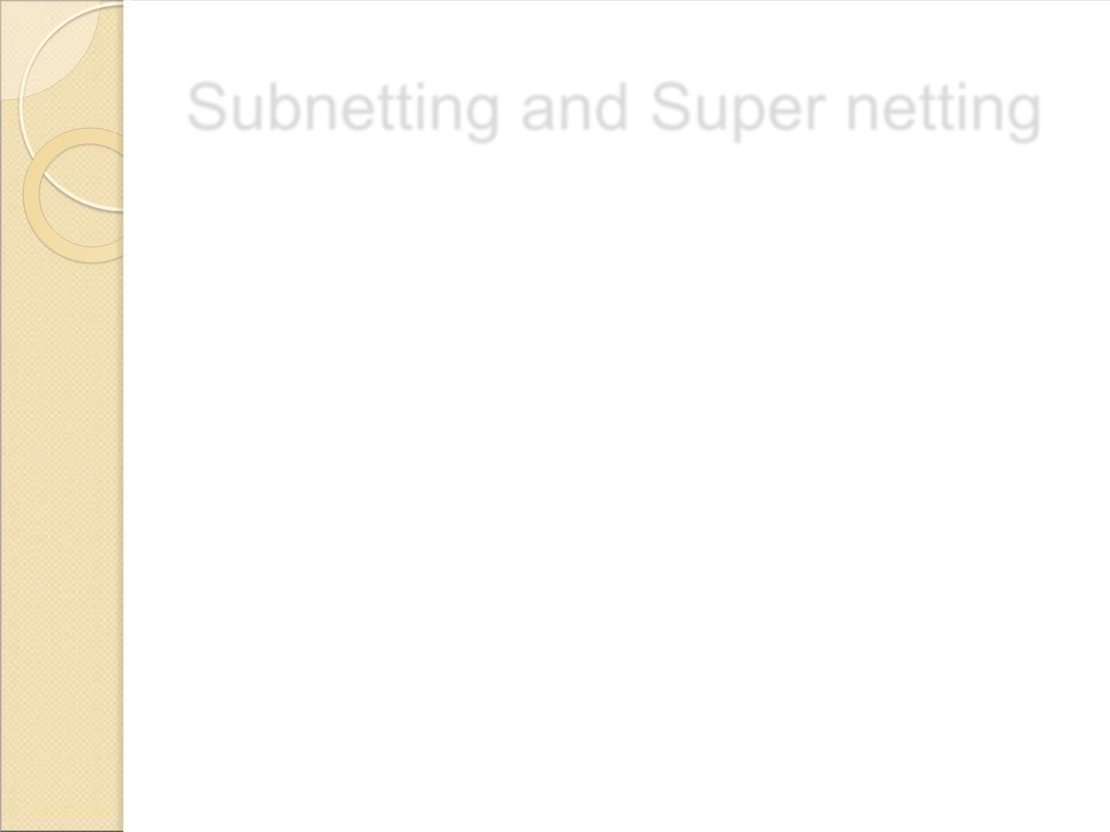
Subnetting and Super netting
 Subnetting is the procedure to divide the network into sub-
networks or small networks.
 Super netting is the procedure of combine the small networks
into larger space.
 In subnetting, Network addresses’s bits are increased. on the
other hand, in subnetting, Host addresses’s bits are increased.
 Subnetting is implemented via Variable-length subnet
masking, While supernetting is implemented via Classless
interdomain routing.
68

Slide 67

69

Slide 68


Slide 69
Subnetting
 When a bigger network is divided into
smaller networks, in order to maintain
security, then that is known as
Subnetting. so, maintenance is easier
for smaller networks.
71

Slide 70

What is the subnetwork address if the destination
address is 200.45.34.56 and the subnet mask is
255.255.240.0 ?
Solution:
 Convert the given destination address into binary
format.
200.45.34.56 = 11001000 00101101 00100010 00111000
 Convert the given subnet mask into binary format.
255.255.240.0 = 11111111 11111111 11110000 00000000
 Do the AND operation using destination address
and subnet mask address.
200.45.34.56 = 11001000 00101101 00100010 00111000
255.255.240.0 = 11111111 11111111 11110000 00000000
11001000 00101101 00100000 00000000
subnetwork address is 200.45.32.0
72

Slide 71

Find the subnetwork address for
the following:
S.No IP address Mask
A
140.11.36.22 255.255.255.0
Solution:
IP address 140.11.36.22
Mask 255.255.255.0
140.11.36.0
73

Slide 72

CLASSLESS ADDRESSING
 In classless addressing, variable-length blocks
are used that belong to no classes.
 We can have a block of 1 address, 2
addresses, 4 addresses, 128 addresses, and
so on.
 In classless addressing, the whole address
space is divided into variable length blocks.
 The prefix in an address defines the block
(network); the suffix defines the node (device).
 The number of addresses in a block needs to
be a power of 2.
 An organization can be granted one block of
addresses.
74

Slide 73

CLASSLESS ADDRESSING
• The prefix length in classless addressing is variable.
• We can have a prefix length that ranges from 0 to 32.
• The size of the network is inversely proportional to the length
of the prefix.
• A small prefix means a larger network; a large prefix means a
smaller network.
• The idea of classless addressing can be easily applied to
classful addressing.
• An address in class A can be thought of as a classless
address in which the prefix length is 8.
• An address in class B can be thought of as a classless
address in which the prefix is 16, and so on. In other words,
classful addressing is a special case of classless addressing.
75

Slide 74

Notation used in Classless
Addressing
 The notation used in classless addressing is
informally referred to as slash notation and formally
as classless interdomain routing or CIDR.
 For example , 192.168.100.14 /24 represents the
IP address 192.168.100.14 and, its subnet mask
255.255.255.0, which has 24 leading 1-bits.
76

Slide 75

Address Aggregation
 One of the advantages of the CIDR strategy
is address aggregation (sometimes called
address summarization or route
summarization).
 When blocks of addresses are combined to
create a larger block, routing can be done
based on the prefix of the larger block.
 ICANN assigns a large block of addresses to
an ISP.
77

Slide 76

Special Addresses in IPv4
 There are five special addresses that are used for
special purposes:
➢this-host address,
➢limited-broadcast address,
➢ loopback address,
➢private addresses, and
➢multicast addresses.
78

Slide 77

Thi host Address
 The only address in the block
0.0.0.0/32 is called the this-host
address.
 It is used whenever a host needs to
send an IP datagram but it does not
know its own address to use as the
source address.
79

Slide 78

Limite broadcast Address
 The only address in the block
255.255.255.255/32 is called the
limitedbroadcast address.
 It is used whenever a router or a host
needs to send a datagram to all devices
in a network.
 The routers in the network, however,
block the packet having this address as
the destination;the packet cannot travel
outside the network.
80

Slide 79
Loopback Address
 The block 127.0.0.0/8 is called the
loopback address.
 A packet with one of the addresses in
this block as the destination address
never leaves the host; it will remain in
the host.
Private Addresses
 Four blocks are assigned as private
addresses: 10.0.0.0/8, 172.16.0.0/12,
 192.168.0.0/16, and 169.254.0.0/16.
Multicast Addresses
 The block 224.0.0.0/4 is reserved for
multicast addresses.
81

Slide 80

DHCP – DYNAMIC HOST
CONFIGURATION PROTOCOL
 The dynamic host configuration protocol is
used to simplify the installation and
maintenance of networked computers.
 DHCP is derived from an earlier protocol
called BOOTP.
 Ethernet addresses are configured into
network by manufacturer and they are
unique.
 IP addresses must be unique on a given
internetwork but also must reflect the
structure of the internetwork.
 The main goal of DHCP is to minimize the
amount of manual configuration required for a
host.
82

Slide 81
 If a new computer is connected to a network,
DHCP can provide it with all the necessary
information for full system integration into the
network.
 DHCP is based on a client/server model.
 DHCP clients send a request to a DHCP
server to which the server responds with an
IP address
 DHCP server is responsible for providing
configuration information to hosts.
 There is at least one DHCP server for an
administrative domain.
 The DHCP server can function just as a
centralized repository for host configuration
information.
 The DHCP server maintains a pool of
available addresses that it hands out to hosts
on demand.
83

Slide 82

DHCP – DYNAMIC HOST
CONFIGURATION PROTOCOL
84

Slide 83

DHCP – DYNAMIC HOST
CONFIGURATION PROTOCOL
 A newly booted or attached host sends a
DHCPDISCOVER message to a special IP
address (255.255.255.255., which is an IP
broadcast address.
 This means it will be received by all hosts and
routers on that network.
 DHCP uses the concept of a relay agent. There
is at least one relay agent on each network.
 DHCP relay agent is configured with the IP
address of the DHCP server.
 When a relay agent receives a DHCPDISCOVER
message, it unicasts it to the DHCP server and
awaits the response, which it will then send back
to the requesting client.
85

Slide 84

DHCP – DYNAMIC HOST
CONFIGURATION PROTOCOL
86

Slide 85

DHCP Message Format
87

Slide 86

NETWORK ADDRESS
TRANSLATION (NAT)
 A technology that can provide the mapping
between the private and universal
(external)addresses, and at the same time
support virtual private networks is called as
Network Address Translation (NAT).
 The technology allows a site to use a set of
private addresses for internal communication
and a set of global Internet addresses (at
least one) for communication with the rest of
the world.
 The site must have only one connection to
the global Internet through a NAT capable
router that runs N AT software.
88

Slide 87

NETWORK ADDRESS
TRANSLATION (NAT)
89

Slide 88

Types of NAT
 Two types of N AT exists .
(a) One-to-one translation of IP
addresses
(b) One-to-many translation of IP
addresses
90

Slide 89
Address Translation
 All of the outgoing packets go through the
NAT router, which replaces the source
address in the packet with the global NAT
address.
 All incoming packets also pass through the
NAT router, which replaces the destination
address in the packet (the NAT router global
address) with the appropriate private
address.
Translation Table
 There may be tens or hundreds of private IP
addresses, each belonging to one specific
host.
 The problem arises when we want to
translate the source address to an external
91

Slide 90

Network Layer Protocols: IP
 The IP (Internet Protocol) is a protocol that
uses datagrams to communicate over a packet-switched
network. The IP protocol operates at the network layer
protocol of the OSI reference model and is a part of a
suite of protocols known as TCP/IP.
 The IP network service transmits datagrams between
intermediate nodes using IP routers.
92

Slide 91
Network Layer Protocols: IP
 The routers themselves are simple, since no information is
stored concerning the datagrams which are forwarded on a
link.
 The most complex part of an IP router is concerned with
determining the optimum link to use to reach each destination
in a network.
 This process is known as "routing". Although this process is
computationally intensive, it is only performed at periodic
intervals.
93

Slide 92

ICM Internet Control Message
Protocol
 Since IP does not have a inbuilt mechanism for sending error
and control messages. It depends on Internet Control Message
Protocol(ICMP) to provide an error control.
 It is used for reporting errors and management queries. It is a
supporting protocol and used by networks devices like routers
for sending the error messages and operations information.
e.g. the requested service is not available or that a host or
router could not be reached.
94

Slide 93

ICMP
 The Internet Control Message Protocol (ICMP) is
a network layer protocol used by network devices to
diagnose network communication issues.
 ICMP is mainly used to determine whether or not data is
reaching its intended destination in a timely manner.
 Commonly, the ICMP protocol is used on network
devices, such as routers.
 ICMP is crucial for error reporting and testing, but it can
also be used in distributed denial-of-service (DDoS)
attacks.
95

Slide 94

What is ICMP used for?
 The primary purpose of ICMP is for error reporting.
 When two devices connect over the Internet, the ICMP
generates errors to share with the sending device in the
event that any of the data did not get to its intended
destination.
 For example, if a packet of data is too large for a router,
the router will drop the packet and send an ICMP
message back to the original source for the data.
96

Slide 95
 A secondary use of ICMP protocol is to perform network
diagnostics; the commonly used terminal utilities traceroute and
ping both operate using ICMP.
 The traceroute utility is used to display the routing path between
two Internet devices.
 The routing path is the actual physical path of connected routers
that a request must pass through before it reaches its destination.
 The journey between one router and another is known as a ‘hop,’
and a traceroute also reports the time required for each hop along
the way. This can be useful for determining sources of network
delay.
97

Slide 96

ICMP MESSAGE TYPES
 ICMP messages are divided into two broad
categories: error-reporting messages and query
messages.
 The error-reporting messages report problems that
a router or a host (destination) may encounter
when it processes an IP packet.
 The query messages help a host or a network
manager get specific information from a router or
another host.
98

Slide 97

99

Slide 98

ICMP Erro – Reporting Messages
100

Slide 99
 Destination Unreachable―When a router cannot route a
datagram, the datagram is discarded and sends a destination
unreachable message to source host.
 Source Quench―When a router or host discards a
datagram due to congestion, it sends a source-quench
message to the source host. This message acts as flow
control.
 Time Exceeded―Router discards a datagram when TTL
field becomes 0 and a time exceeded message is sent to the
source host.
 Parameter Problem―If a router discovers ambiguous or
missing value in any field of the datagram, it discards the
datagram and sends parameter problem message to source.
 Redirection―Redirect messages are sent by the default
router to inform the source host to update its forwarding table
when the packet is routed on a wrong path.
101

Slide 100

Source quench message
 Source quench message is request to decrease traffic rate
for messages sending to the host(destination). Or we can
say, when receiving host detects that rate of sending
packets (traffic rate) to it is too fast it sends the source
quench message to the source to slow the pace down so
that no packet can be lost.
102

Slide 101

 ICMP will take source IP from the discarded packet and
informs to source by sending source quench message.
 Then source will reduce the speed of transmission so
that router will free for congestion.
 When the congestion router is far away from the source
the ICMP will send hop by hop source quench message
so that every router will reduce the speed of
transmission.
103

Slide 102

Parameter Problem
 Whenever packets come to the router then calculated
header checksum should be equal to received header
checksum then only packet is accepted by the router.
104

Slide 103
 If there is mismatch packet will be dropped by the
router.
 ICMP will take the source IP from the discarded packet
and informs to source by sending parameter problem
message.
105

Slide 104

Time Exceeded Message
 When some fragments are lost in a network then the holding
fragment by the router will be dropped then ICMP will take
source IP from discarded packet and informs to the source,
of discarded datagram due to time to live field reaches to
zero, by sending time exceeded message.
106

Slide 105

Destination unreachable
 Destination unreachable is generated by the host or its
inbound gateway to inform the client that the destination
is unreachable for some reason.
 There is no necessary condition that only router give the
ICMP error message some time destination host send
ICMP error message when any type of failure (link
failure,hardware failure,port failure etc) happen in the
network.
107

Slide 106

Redirection message
 Redirect requests data packets be sent on an alternate
route. The message informs to a host to update its
routing information (to send packets on an alternate
route).
 Ex. If host tries to send data through a router R1 and R1
sends data on a router R2 and there is a direct way from
host to R2. Then R1 will send a redirect message to
inform the host that there is a best way to the destination
directly through R2 available. The host then sends data
packets for the destination directly to R2.
108

Slide 107

Redirection message
 The router R2 will send the original datagram to the
intended
destination.
But if datagram contains routing information then this
message will not be sent even if a better route is
available as redirects should only be sent by gateways
and should not be sent by Internet hosts.
109

Slide 108

ICMP Query Messages
110

Slide 109

ICMP Query Messages
 Echo Request & Reply―Combination of echo request
and reply messages determines whether two systems
communicate or not.
 Timestamp Request & Reply―Two machines can use
the timestamp request and reply messages to
determine the round-trip time (RTT).
 Address Mask Request & Reply―A host to obtain its
subnet mask, sends an address mask request message
to the router, which responds with an address mask
reply message.
 Router
Solicitation/Advertisement―A
host
broadcasts a router solicitation message to know about
the router. Router broadcasts its routing information
with router advertisement message.
111

Slide 110

ICMP MESSAGE FORMAT
112

Slide 111

ICMP DEBUGGING TOOLS
 Two tools are used for debugging purpose.
They are
(1) Ping
(2) Traceroute
113

Slide 112

Ping
 The ping program is used to find if a host is alive and
responding.
 The source host sends ICMP echo-request messages;
the destination, if alive,responds with ICMP echo-reply
messages.
 The ping program sets the identifier field in the echo-
request and echo-reply message and starts the
sequence number from 0; this number is incremented
by 1 each time a new message is sent.
 The ping program can calculate the round-trip time.
 It inserts the sending time in the data section of the
message.
 When the packet arrives, it subtracts the arrival time
from the departure time to get the round-trip time (RTT).
$ ping google.com
114

Slide 113

Traceroute o Tracert
 The traceroute program in UNIX or
tracert in Windows can be used to trace
the path of a packet from a source to the
destination.
 It can find the IP addresses of all the
routers that are visited along the path.
 The program is usually set to check for
the maximum of 30 hops (routers) to be
visited.
 The number of hops in the Internet is
normally less than this.
$ traceroute google.com
115

Slide 114

Routing
 Routing is a process which is performed by layer
3 (or network layer) devices in order to deliver the
packet by choosing an optimal path from one
network to another.
 There are 3 types of routing:
1. Static routing –
Static routing is a process in which we have to
manually add routes in routing table.
Advantages –
 No routing overhead for router CPU which means
a cheaper router can be used to do routing.
 It adds security because only administrator can
allow routing to particular networks only.
 No bandwidth usage between routers.
116

Slide 115
Disadvantage –
 For a large network, it is a hectic task for
administrator to manually add each route for
the network in the routing table on each
router.
 The administrator should have good
knowledge of the topology. If a new
administrator comes, then he has to manually
add each route so he should have very good
knowledge of the routes of the topology.
117

Slide 116

Default Routing
 This is the method where the router is
configured to send all packets towards a
single router (next hop).
 It doesn’t matter to which network the
packet belongs, it is forwarded out to
router which is configured for default
routing.
 It is generally used with stub routers. A
stub router is a router which has only one
route to reach all other networks.
118

Slide 117

Dynamic Routing
 Dynamic routing makes automatic adjustment of the routes
according to the current state of the route in the routing table.
 Dynamic routing uses protocols to discover network destinations
and the routes to reach it. RIP and OSPF are the best examples of
dynamic routing protocol. Automatic adjustment will be made to
reach the network destination if one route goes down.
 A dynamic protocol have following features:
 The routers should have the same dynamic protocol running in
order to exchange routes.
 When a router finds a change in the topology then router advertises
it to all other routers.
119

Slide 118
Advantages –
 Easy to configure.
 More effective at selecting the best route to a
destination remote network and also for discovering
remote network.
Disadvantage –
 Consumes more bandwidth for communicating with
other neighbors.
 Less secure than static routing.
120

Slide 119

TYPES OF ROUTING PROTOCOLS
 Two types of Routing Protocols are used in
the Internet:
1) Intradomain routing
 Routing within a single autonomous system
 Routing Information Protocol (RIP) - based
on the distance-vector algorithm
 Open Shortest Path First (OSPF) - based on
the link-state algorithm
2) Interdomain routing
 Routing between autonomous systems.
 Border Gateway Protocol (BGP) - based on
the path-vector algorithm
121

Slide 120

Unicast Routing Protocols
 Unicast – Unicast means the transmission from a single
sender to a single receiver. It is a point to point
communication between sender and receiver. There are
various unicast protocols such as TCP, HTTP, etc.
 TCP is the most commonly used unicast protocol. It is a
connection oriented protocol that relay on acknowledgement
from the receiver side.
 HTTP stands for Hyper Text Transfer Protocol. It is an object
oriented protocol for communication.
122

Slide 121

Unicast Routing
 There are three main classes of
routing protocols:
1) Distance Vector Routing Algorithm
– Routing Information Protocol
2) Link State Routing Algorithm –
Open Shortest Path First Protocol
3) Path-Vector Routing Algorithm -
Border Gateway Protocol
123

Slide 122

DISTANCE VECTOR ROUTING (DSR)
 Distance vector routing is distributed, i.e.,
algorithm is run on all nodes.
 Each node knows the distance (cost) to
each of its directly connected neighbors.
 Nodes construct a vector (Destination,
Cost, NextHop) and distributes to its
neighbors.
 Nodes compute routing table of minimum
distance to every other node via
 NextHop using information obtained from its
neighbors.
124

Slide 123

Initial State
125

Slide 124

Initial State
 In given network, cost of each link is 1
hop.
 Each node sets a distance of 1 (hop) to
its immediate neighbor and cost to itself
as 0.
 Distance for non-neighbors is marked as
unreachable with value ∞ (infinity).
 For node A, nodes B, C, E and F are
reachable, whereas nodes D and G are
unreachable.
126

Slide 125

127

Slide 126

 The initial table for all the nodes are
given below
4/5/2022 Karpagam Institute of Technology
128

Slide 127

29

Slide 128

130

Slide 129
 System stabilizes when all nodes have
complete routing information, i.e.,
convergence.
 Routing tables are exchanged periodically
or in case of triggered update.
 The final distances stored at each node is
given below:
131

Slide 130

132

Slide 131

Updation of Routing Tables
 There are two different circumstances
under which a given node decides to
send a routing update to its neighbors.
1.Periodic Update
2. Triggered Update
133

Slide 132
Periodic Update
 In this case, each node automatically sends
an update message every so often, even if
nothing has changed.
 The frequency of these periodic updates
varies from protocol to protocol, but it is
typically on the order of several seconds to
several minutes.
Triggered Update
 In this case, whenever a node notices a link
failure or receives an update from one of its
neighbors that causes it to change one of the
routes in its routing table.
 Whenever a node’s routing table changes, it
sends an update to its neighbors, which may
lead to a change in their tables, causing them
to send an update to their neighbors.
134

Slide 133

Coun T Infinity (or) Loop
Instability Problem
 Suppose link from node A to E goes
down.
➢Node A advertises a distance of ∞ to E to
its neighbors
➢Node B receives periodic update from C
before A’s update reaches B
➢Node B updated by C, concludes that E
can be reached in 3 hops via C
➢Node B advertises to A as 3 hops to
reach E
➢Node A in turn updates C with a distance
135

Slide 134
 Thus nodes update each other until
cost to E reaches infinity, i.e., no
convergence.
 Routing table does not stabilize.
 This problem is called loop instability
or count to infinity
4/5/2022 Karpagam Institute of Technology
136

Slide 135

Solution to Coun T Infinity (or)
Loop Instability Problem :
 Infinity is redefined to a small number, say
16.
 Distance between any two nodes can be 15
hops maximum. Thus distance vector
routing cannot be used in large networks.
 When a node updates its neighbors, it does
not send those routes it learned from each
neighbor back to that neighbor. This is
known as split horizon.
 Split horizon with poison reverse allows
nodes to advertise routes it learnt from a
node back to that node, but with a warning
4/5/2022 Karpagam Institute of Technology
137

Slide 136

ROUTING INFORMATION PROTOCOL (RIP)
 RIP is an intra-domain routing protocol
based on distance-vector algorithm.
138

Slide 137

ROUTING INFORMATION PROTOCOL (RIP)
 Routers advertise the cost of reaching networks.
Cost of reaching each link is 1hop.
 For example, router C advertises to A that it can
reach network 2, 3 at cost 0 (directly connected),
networks 5, 6 at cost 1 and network 4 at cost 2.
 Each router updates cost and next hop for each
network number.
 Infinity is defined as 16, i.e., any route cannot have
more than 15 hops.
 Therefore RIP can be implemented on small-sized
networks only.
 Advertisements are sent every 30 seconds or in
case of triggered update.
139

Slide 138

• Command - It indicates the packet type.
• Value 1 represents a request packet. Value 2 represents a
response packet.
• Version - It indicates the RIP version number. For RIPv1, the
value is 0x01.
• Address Family Identifier - When the value is 2, it represents
the IP protocol.
• IP Address - It indicates the destination IP address of the route. It
can be the addresses of only the natural network segment.
• Metric - It indicates the hop count of a route to its destination.
4/5/2022 Karpagam Institute of Technology
140

Slide 139

LINK STAT E ROUTING (LSR)
 Each node knows state of link to its neighbors
and cost.
 Nodes create an update packet called link-state
packet (LSP) that contains:
➢ID of the node
➢List of neighbors for that node and associated cost
➢64-bit Sequence number
➢Time to live
 Link-State routing protocols rely on two
mechanisms:
➢Reliable flooding of link-state information to all other
nodes
➢Route calculation from the accumulated link-state
knowledge
141

Slide 140

Link State Routing
Link state routing is a technique in which each router shares the knowledge
of its neighborhood with every other router in the internetwork.
The three keys to understand the Link State Routing algorithm:
•Knowledge about the neighborhood: Instead of sending its routing table,
a router sends the information about its neighborhood only. A router
broadcast its identities and cost of the directly attached links to other
routers.
•Flooding: Each router sends the information to every other router on the
internetwork except its neighbors. This process is known as Flooding.
Every router that receives the packet sends the copies to all its neighbors.
Finally, each and every router receives a copy of the same information.
•Information sharing: A router sends the information to every other router
only when the change occurs in the information.
142

Slide 141

Link state Routing
 Link state routing is the second family of routing protocols.
 While distance vector routers use a distributed algorithm to
compute their routing tables, link-state routing uses link-state
routers to exchange messages that allow each router to learn
the entire network topology.
 Based on this learned topology, each router is then able to
compute its routing table by using a shortest path
computation.
 Features of link state routing protocols –
 Link state packet – A small packet that contains routing
information.
 Link state database – A collection information gathered
from link state packet.
 Shortest path first algorithm (Dijkstra algorithm) – A
calculation performed on the database results into shortest
path
 Routing table – A list of known paths and interfaces.
143

Slide 142

Working Principle
 Discover its neighbors and learn their
network addresses.
 Measure the delay or cost to each of
its neighbours.
 Construct a packet telling all it has just
learned.
 Send this packet to all other routers
and
 Compute the shortest path to every
other router.
144

Slide 143

Step 1 Information Sharing
 The first step in link state routing is
information sharing.
 Each router sends its knowledge
about its neighborhood to every other
router in the internetwork.
145

Slide 144

Step 2 Measuring Packet
Cost
 Both distance vector and link state routing are
lowest cost algorithms.
 In distance vector routing, cost refers to hop
count.
 In link state routing, cost is a weighted value
based on a variety of factors such as security
levels, traffic or the state of the link.
 The cost from router A to network 1, therefore,
might be different from the cost from A to network
2.
 Cost is applied only by routers and not by any
other stations on a network.
 In determining a route, the cost of a hop is
applied to each packet as it leaves a router and
enters a network.
146

Slide 145

Cost in link state routing
147

Slide 146

Step 3 Building link state
packet
 When a router floods the network with
information about its neighbourhood, it
is said to be advertising.
 In link state routing, a small packet
containing routing information sent by
the router to all other routers is
referred as Link-State Packet(LSP).
148

Slide 147

Link State Packet Format
 Link- State Packet contains 4 fields
❖ The ID of the advertiser
The ID of the destination network
The cost
The ID of the neighbor router
149

Slide 148

Link State Packet Format
150

Slide 149

Step 4: Flooding of LSP
151

Slide 150

Step 4: Flooding of LSP
 After creating LSP, every router
forwards it to each and every other
router in the internet.
 Link State Database – With the help of
the information in the every LSP
packet, which is received by every
router and it creates a common
database to all routers is referred as
Link State Database.
 Every router stores this database on its disk, and uses it for routing
packets.
152

Slide 151

Link State Database
153

Slide 152

Step 5: Computing shortest path
tree
 Once the link state database has been
created, each router applies an
algorithm called Dijkstra algorithm to
it, in order to calculate its routing table.
154

Slide 153

Shortest Path Routing
 2 algorithms for computing the
shorstest path between two nodes of a
graph are known.
1. Dijkstra’s algorithm
2. Bellman-Ford algorithm
155

Slide 154

Calculation of Shortest Path
 To find shortest path, each node need to run the
famous Dijkstra algorithm. This famous algorithm
uses the following steps:
 Step-1: The node is taken and chosen as a root node
of the tree, this creates the tree with a single node, and
now set the total cost of each node to some value
based on the information in Link State Database
 Step-2: Now the node selects one node, among all the
nodes not in the tree like structure, which is nearest to
the root, and adds this to the tree.The shape of the tree
gets changed .
 Step-3: After this node is added to the tree, the cost of
all the nodes not in the tree needs to be updated
because the paths may have been changed.
all the nodes are added in the tree
 Step-4: The node repeats the Step 2. and Step 3. until
156

Slide 155

Example
157

Slide 156

158

Slide 157

159

Slide 158

160

Slide 159
Open Shortest Path First (OSPF)
Protocol fundamentals
 Open shortest path first (OSPF) is a link-state routing
protocol which is used to find the best path between the
source and the destination router using its own shortest
path first (SPF) algorithm.
 A link-state routing protocol is a protocol which uses the
concept of triggered updates, i.e., if there is a change
observed in the learned routing table then the updates are
triggered only, not like the distance-vector routing protocol
where the routing table are exchanged at a period of time.
161

Slide 160
 It is a network layer protocol which works on the protocol
number 89 and uses AD value 110. OSPF uses multicast
address 224.0.0.5 for normal communication and 224.0.0.6
for update to designated router(DR)/Backup Designated
Router (BDR).
 Criteria
–
To form neighbourship in OSPF, there is a criteria for both
the routers:
 It should be present in same area
 Router I’d must be unique
 Subnet mask should be same
 Hello and dead timer should be same
 Stub flag must match
 Authentication must match
162

Slide 161

OSPF message –
 OSPF messages –
OSPF uses certain messages for the communication
between the routers operating OSPF.
 Hello message – These are keep alive messages used for
neighbor discovery /recovery. These are exchanged in
every 10 seconds. This include following information :
Router I’d, Hello/dead interval, Area I’d, Router priority,
DR and BDR IP address, authentication data.
 Database Description (DBD) – It is the OSPF routes of
the router. This contains topology of an AS or an area
(routing domain).
163

Slide 162
OSPF message –
 Link state request (LSR) – When a router receive
DBD, it compares it with its own DBD. If the DBD
received has some more updates than its own DBD then
LSR is being sent to its neighbor.
 Link state update (LSU) – When a router receives
LSR, it responds with LSU message containing the
details requested.
 Link state acknowledgement – This provides reliability
to the link state exchange process. It is sent as the
acknowledgement of LSU.
 Link state advertisement (LSA) – It is an OSPF data
packet that contains link-state routing information,
shared only with the routers to which adjacency has
been formed.
164

Slide 163

Timers –
 Hello timer – The interval in which OSPF router sends
a hello message on an interface. It is 10 seconds by
default.
 Dead timer – The interval in which the neighbor will be
declared dead if it is not able to send the hello packet . It
is 40 seconds by default.It is usually 4 times the hello
interval but can be configured manually according to
need.
165

Slide 164

OSPF
supports/provides/advantages
–
 Both IPv4 and IPv6 routed protocols
 Load balancing with equal cost routes for same
destination
 VLSM and route summarization
 Unlimited hop counts
 Trigger updates for fast convergence
 A loop free topology using SPF algorithm
 Run on most routers
 Classless protocol
166

Slide 165
Open shortest path first
(OSPF) router roles –
 An area is a group of contiguous network and routers.
Routers belonging to same area shares a common
topology table and area I’d. The area I’d is associated
with router ’s interface as a router can belong to more
than one area. There are some roles of router in OSPF:
167

Slide 166

OSPF
168

Slide 167
Area Border Router
 At the borders of an area, special
routers are present called as area
border routers, it is used to summarize
the information about the area and
send it to the other areas.
 These routers belong to both an area
and the backbone.
 These routers are responsible for
routing packets outside the area
through backbone router.
169

Slide 168

Backbone Router
 Among the areas inside an
autonomous system, is a special area
called the backbone and the routers
inside the backbone is called
backbone routers.
 The primary role of the backbone area
is to route traffic between the other
areas in an AS.
 This router constructs a complete
topological map of the entire
autonomous system.
170

Slide 169

Boundary Routers
 A boundary router exchanges routing
information with routers belonging to
others autonomous systems
171

Slide 170

Internal Routers
 These routers are in non backbone
areas and perform only intra AS
routing in the area.
172

Slide 171
 Area Summary Border Router (ASBR) – When an
OSPF router is connected to a different protocol like
EIGRP, or Border Gateway Protocol, or any other
routing protocol then it is known as AS.
 The router which connects two different AS (in which
one of the interface is operating OSPF) is known as Area
Summary Border Router.
 These routers perform redistribution. ASBRs run both
OSPF and another routing protocol, such as RIP or BGP.
ASBRs advertise the exchanged external routing
information throughout their AS.
173

Slide 172

OSPF terms –
 Router I’d – It is the highest active IP address present
on the router. First, highest loopback address is
considered. If no loopback is configured then the highest
active IP address on the interface of the router is
considered.
 Router priority – It is a 8 bit value assigned to a router
operating OSPF, used to elect DR and BDR in a
broadcast network.
174

Slide 173
OSPF terms –
 Designated Router (DR) – It is elected to minimize the
number of adjacency formed. DR distributes the LSAs
to all the other routers. DR is elected in a broadcast
network to which all the other routers shares their DBD.
In a broadcast network, router requests for an update to
DR and DR will respond to that request with an update.
 Backup Designated Router (BDR) – BDR is backup to
DR in a broadcast network. When DR goes down, BDR
becomes DR and performs its functions.
175

Slide 174

OSPF terms –
 DR and BDR election – DR and BDR election takes
place in broadcast network or multi-access network.
Here are the criteria for the election:
 Router having the highest router priority will be declared
as DR.
 If there is a tie in router priority then highest router I’d
will be considered. First, the highest loopback address is
considered. If no loopback is configured then the highest
active IP address on the interface of the router is
considered.
176

Slide 175

OSPF states –
The device operating OSPF goes through certain states. These
states are:
 Down – In this state, no hello packet have been received on the
interface.
Note – The Down state doesn’t mean that the interface is
physically down. Here, it means that OSPF adjacency process
has not started yet.
 INIT – In this state, hello packet have been received from the
other router.
 2 WAY – In the 2 WAY state, both the routers have received the
hello packets from other routers. Bidirectional connectivity has
been
established.
Note – In between the 2 WAY state and Exstart state, the DR and
BDR election takes place.
177

Slide 176
 Exstart – In this state, NULL DBD are exchanged.In
this state, master and slave election take place. The
router having the higher router I’d becomes the master
while other becomes the slave. This election decides
Which router will send it’s DBD first (routers who have
formed neighbourship will take part in this election).
 Exchange – In this state, the actual DBDs are
exchanged.
178

Slide 177
 Loading – In this sate, LSR, LSU and LSA (Link State
Acknowledgement) are exchanged.
 Full – In this state, synchronization of all the
information takes place. OSPF routing can begin only
after the Full state.
179

Slide 178

OSPF Message Format
180

Slide 179
OSPF Message Format
 Version: It is an 8-bit field that specifies the OSPF protocol
version.
 Type: It is an 8-bit field. It specifies the type of the OSPF
packet.
 Message: It is a 16-bit field that defines the total length of the
message, including the header. Therefore, the total length is
equal to the sum of the length of the message and header.
 Source IP address: It defines the address from which the
packets are sent. It is a sending routing IP address.
 Area identification: It defines the area within which the
routing takes place.
 Checksum: It is used for error correction and error detection.
 Authentication type: There are two types of authentication,
i.e., 0 and 1. Here, 0 means for none that specifies no
authentication is available and 1 means for pwd that specifies
the password-based authentication.
 Authentication: It is a 32-bit field that contains the actual
value of the authentication data.
181

Slide 180

Link State Advertisement
(LSA)
182

Slide 181
• Link state ID—ID of the router that originated the LSA.
• V (Virtual Link)—Set to 1 if the router that originated the LSA is a virtual link
endpoint.
• E (External)—Set to 1 if the router that originated the LSA is an ASBR.
• B (Border)—Set to 1 if the router that originated the LSA is an ABR.
• # Links—Number of router links (interfaces) to the area, as described in the LSA.
• Link ID—Determined by link type.
• Link data—Determined by link type.
• Type—Link type. A value of 1 indicates a point-to-point link to a remote router; a
value of 2 indicates a link to a transit network; a value of 3 indicates a link to a stub
network; and a value of 4 indicates a virtual link.
• #TOS—Number of different TOS metrics given for this link. If no TOS metric is
given for the link, this field is set to 0. TOS is not supported in RFC 2328. The #TOS
field is reserved for early versions of OSPF.
• Metric—Cost of using this router link.
• TOS—IP Type of Service that this metric refers to.
• TOS metric—TOS-specific metric information.
183

Slide 182

PAT H VECTOR ROUTING (PVR)
 Path-vector routing is an asynchronous
and distributed routing algorithm.
 The Path-vector routing is not based on
least-cost routing.
 The best route is determined by the
source using the policy it imposes on the
route.
 In other words, the source can control
the path.
 Path-vector routing is not actually used
in an internet, and is mostly designed to
route a packet between ISPs.
184

Slide 183

Spanning Trees
 In path-vector routing, the path from a source to all
destinations is determined by the best spanning
tree.
 The best spanning tree is not the least-cost tree.
 It is the tree determined by the source when it
imposes its own policy.
 If there is more than one route to a destination, the
source can choose the route that meets its policy
best.
 A source may apply several policies at the same
time.
 One of the common policies uses the minimum
number of nodes to be visited.
 Another common policy is to avoid some nodes as
the middle node in a route.
185

Slide 184
 The spanning trees are made, gradually and
asynchronously, by each node.
 When a node is booted, it creates a path vector based
on the information it can obtain about its immediate
neighbor.
 A node sends greeting messages to its immediate
neighbors to collect these pieces of information.
 Each node, after the creation of the initial path vector,
sends it to all its immediate neighbors.
 Each node, when it receives a path vector from a
neighbor, updates its path vector using the formula
 The policy is defined by selecting the best of multiple
paths.
 Path-vector routing also imposes one more condition on
this equation.
 If Path (v, y) includes x, that path is discarded to avoid
a loop in the path.
 In other words, x does not want to visit itself when it
selects a path to y.
186

Slide 185

Example:
187

Slide 186
 Each source has created its own
spanning tree that meets its policy.
 The policy imposed by all sources is to
use the minimum number of nodes to
reach a destination.
 The spanning tree selected by A and E
is such that the communication does
not pass through D as a middle node.
 Similarly, the spanning tree selected
by B is such that the communication
does not pass through C as a middle
node.
188

Slide 187

Path Vectors made at booting time
 The Figure below shows all of these
path vectors for the example.
 Not all of these tables are created
simultaneously.
 They are created when each node is
booted.
 The figure also shows how these path
vectors are sent to immediate
neighbors after they have been
created.
189

Slide 188

Path Vectors made at booting
time
190

Slide 189

BORDER GATEWAY
PROTOCOL (BGP)
 The Border Gateway Protocol version
(BGP) is the only interdomain routing
protocol used in the Internet today.
 BGP4 is based on the path-vector
algorithm. It provides information
about the reachability of networks in
the Internet.
 BGP views internet as a set of
autonomous systems interconnected
arbitrarily.
191

Slide 190

BORDER GATEWAY PROTOCOL (BGP)
192

Slide 191
 Each AS have a border router (gateway),
by which packets enter and leave that
AS. In above figure, R3 and R4 are
border routers.
 One of the router in each autonomous
system is designated as BGP speaker.
 BGP Speaker exchange reachability
information with other BGP speakers,
known as external BGP session.
 BGP advertises complete path as
enumerated list of AS (path vector) to
reach a particular network.
 Paths must be without any loop, i.e., AS
list is unique.
193

Slide 192

 For example, backbone network
advertises that networks 128.96 and
192.4.153 can be reached along the
path <AS1, AS2, AS4>.
194

Slide 193
 If there are multiple routes to a destination,
BGP speaker chooses one based on policy.
 Speakers need not advertise any route to a
destination, even if one exists.
 Advertised paths can be cancelled, if a
link/node on the path goes down. This negative
advertisement is known as withdrawn route.
 Routes are not repeatedly sent. If there is no
change, keep alive messages are sent.
iBGP - interior BGP
 A Variant of BGP
 Used by routers to update routing information
learnt from other speakers to routers inside the
autonomous system.
 Each router in the AS is able to determine the
appropriate next hop for all prefixes.
195

Slide 194

MULTICASTING
196

Slide 195

MULTICASTING Basic
 In multicasting, there is one source and a group of
destinations.
 Multicast supports efficient delivery to multiple
destinations.
 The relationship is one to many or many-to-many.
 One-to-Many (Source Specific Multicast)
o Radio station broadcast
o Transmitting news, stock-price
o Software updates to multiple hosts
 Many-to-Many (Any Source Multicast)
o Multimedia teleconferencing
o Online multi-player games
o Distributed simulations
 In this type of communication, the source address is a
unicast address, but the destination address is a group
address.
 The group address defines the members of the group.
197

Slide 196

198

Slide 197

Multicasting
 Multicasting works in similar to Broadcasting, but in
Multicasting, the information is sent to the targeted or
specific members of the network.
 This task can be accomplished by transmitting individual
copies to each user or node present in the network, but
sending individual copies to each user is inefficient and
might increase the network latency.
 To overcome these shortcomings, multicasting allows a
single transmission that can be split up among the
multiple users, consequently, this reduces the bandwidth of
the signal.
199

Slide 198

Applications :
Multicasting is used in many areas like:
 Bulk data transfer – for example, the transfer of the
software upgrade from the software developer to users
needing the upgrade.
 Internet protocol (IP)
 Streaming Media – for example, the transfer of the
audio, video and text of the live lecture to a set of
distributed lecture participants.
 It also supports video conferencing applications and
webcasts.
 Data feeds
 Interactive gaming
200

Slide 199

MULTICAST ROUTING
 There are two types of Multicast Distribution Trees used
in multicast routing.
 They are
Source-Based Tree: (DVMRP)
 For each combination of (source , group), there is a
shortest path spanning tree.
Flood and prune
 Send multicast traffic everywhere
 Prune edges that are not actively subscribed to group
Link-state
 Routers flood groups they would like to receive
 Compute shortest-path trees on demand
Shared Tree (PIM)
 Single distributed tree shared among all sources
 Specify rendezvous point (RP) for group
 Senders send packets to R P, receivers join at RP
201

Slide 200

MULTICAST ROUTING PROTOCOLS
 Internet multicast is implemented on
physical networks that support
broadcasting by extending forwarding
functions.
 Major multicast routing protocols are:
1. Distance-Vector Multicast Routing Protocol
(DVMRP)
2. Protocol Independent Multicast (PIM)
202

Slide 201

1 Distance Vector Multicast Routing
Protocol
203

Slide 202

204

Slide 203
Multicasting is added to distance-vector
routing in four stages.
 Flooding
 Reverse Path Forwarding (RPF)
 Reverse Path Broadcasting (RPB)
 Reverse Path Multicast (RPM)
205

Slide 204

Flooding
 Router on receiving a multicast packet from source
S to a Destination from NextHop, forwards the
packet on all out-going links.
 Packet is flooded and looped back to S.
 The drawbacks are:
1.It floods a network, even if it has no members
for that group.
2. Packets are forwarded by each router
connected to a LAN, i.e., duplicate flooding
206

Slide 205

Reverse Path Forwarding
(RPF)
 RPF eliminates the looping problem in the
flooding process.
 Only one copy is forwarded and the other copies are discarded
.
 RPF forces the router to forward a multicast
packet from one specific interface: the one
which has come through the shortest path
from the source to the router.
 Packet is flooded but not looped back to S.
207

Slide 206

Reverse Path Forwarding
(RPF)
208

Slide 207

Revers Path Broadcasting (RPB)
 RPB does not multicast the packet, it broadcasts it.
 RPB creates a shortest path broadcast tree from the
source to each destination.
 It guarantees that each destination receives one and only
one copy of the packet.
 We need to prevent each network from receiving more
than one copy of the packet.
 If a network is connected to more than one router, it may
receive a copy of the packet from each router.
 One router identified as parent called designated Router
(DR).
 Only parent router forwards multicast packets from source S
to the attached network.
 When a router that is not the parent of the attached network
receives a multicast packet, it simply drops the packet.
209

Slide 208

Revers Path Broadcasting
(RPB)
210

Slide 209

Revers Path Multicasting (RPM)
 To increase efficiency, the multicast
packet must reach only those networks that
have active members for that particular
group.
 RPM adds pruning and grafting to RPB to
create a multicast shortest path tree that
supports dynamic membership changes.
211

Slide 210

212

Slide 211

213

Slide 212

Protocol Independent Multicast (PIM)
214

Slide 213

Example
 Router R4 sends Join message for group G
to rendezvous router RP.
 Join message is received by router R2. It
makes an entry (*, G) in its table and
forwards the message to RP.
 When R5 sends Join message for group G,
R2 does not forwards the Join. It adds an
outgoing interface to the forwarding table
created for that group.
215

Slide 214

216

Slide 215
 As routers send Join message for a group,
branches are added to the tree, i.e., shared.
 Multicast packets sent from hosts are forwarded
to designated router RP.
 Suppose router R1, receives a message to group
G.
o R1 has no state for group G.
o Encapsulates the multicast packet in a
Register
message.
o Multicast packet is tunneled along the way to
RP.
 RP decapsulates the packet and sends multicast
packet onto the shared tree, towards R2.
 R2 forwards the multicast packet to routers R4
217
and R5 that have members for group G.

Slide 216

Sourc Specific Tree
 RP can force routers to know about group
G, by sending Join message to the sending
host, so that tunneling can be avoided.
 Intermediary routers create sender-specific
entry (S, G) in their tables. Thus a source-
specific route from R1 to RP is formed.
 If there is high rate of packets sent from a
sender to a group G, then shared tree is
replaced by source-specific tree with
sender as root.
218

Slide 217

Example
219

Slide 218
 Rendezvous router RP sends a Join
message to the host router R1.
 Router R3 learns about group G through
the message sent by R P.
 Router R4 send a source-specific Join due
to high rate of packets from sender.
 Router R2 learns about group G through
the message sent by R4.
 Eventually a source-specific tree is formed
with R1 as root.
220

Slide 219

Analysis of PIM
 Protocol independent because, tree is
based on Join messages via shortest
path.
 Shared trees are more scalable than
source-specific trees.
 Source-specific trees enable efficient
routing than shared trees.
221

Slide 220

IPV6 NEXT GENERATION IP
 IPv6 was evolved to solve address
space problem and offers rich set of
services.
 Some hosts and routers will run IPv4
only, some will run IPv4 and IPv6 and
some will run IPv6 only.
222

Slide 221

DRAWBACKS OF IPV4
 Despite subnetting and CIDR, address
depletion is still a long-term problem.
 Internet must accommodate real-time audio
and video transmission that requires
minimum delay strategies and reservation
of resources.
 Internet must provide encryption and
authentication of data for some applications
223

Slide 222

FEATURES OF IPV6
 Better header format
 New options
 Allowance for extension
 Support for resource allocation
224

Slide 223

Additional Features
1. Need to accommodate scalable routing and addressing
2. Support for real-time services
3. Security support
4. Auto configuration - The ability of hosts to automatically
configure themselves with such information as their own IP
address and domain name.
5. Enhanced routing functionality, including support for mobile
hosts
6. Transition from ipv4 to ipv6
225

Slide 224

ADDRESS SPACE ALLOCATION OF IPV6
226

Slide 225

ADDRESS NOTATION OF IPV6
227

Slide 226

ADDRESS AGGREGATION OF IPV6
228

Slide 227

Extension Headers
229

Slide 228

ADVANCED CAPABILITIES OF IPV6
 Auto Configuration
 Advanced Routing
 Additional Functions
 Security
 Resource allocation
230

Slide 229

ADVANTAGES OF IPV6
 Address space ― IPv6 uses 128-bit
address whereas IPv4 uses 32-bit address.
 Hence IPv6 has huge address space
whereas IPv4 faces address shortage
problem.
 Header format ― Unlike IPv4, optional
headers are separated from base header in
IPv6. Each router thus need not process
unwanted addition information.
 Extensible ― Unassigned IPv6 addresses
can accommodate needs of future
technologies.
231

Slide 230
 In IPv6 representation, we have three addressing
methods :
 Unicast
 Multicast
 Anycast
 Unicast Address: Unicast Address identifies a
single network interface. A packet sent to unicast
address is delivered to the interface identified
by that address
232

Slide 231
Multicast Address:
Multicast Address is used by multiple hosts, called as
Group, acquires a multicast destination address. These
hosts need not be geographically together. If any packet is
sent to this multicast address, it will be distributed to all
interfaces corresponding to that multicast address.
Anycast Address:
Anycast Address is assigned to a group of interfaces. Any
packet sent to anycast address will be delivered to only one
member interface (mostly nearest host possible).
233

Slide 232

PACKET FORMAT OF IPV6
234

Slide 233

PACKET FORMAT OF IPV6
235

